Slide 1

ESTIUM
UI PRESENTATION
Muhammad Arham khan, Mohamad fakhouri, sayed Abdullah qutb, amirhossein maghsoudi, Ahmet berk eren, sarah javaid, esra nur deniz

Slide 3
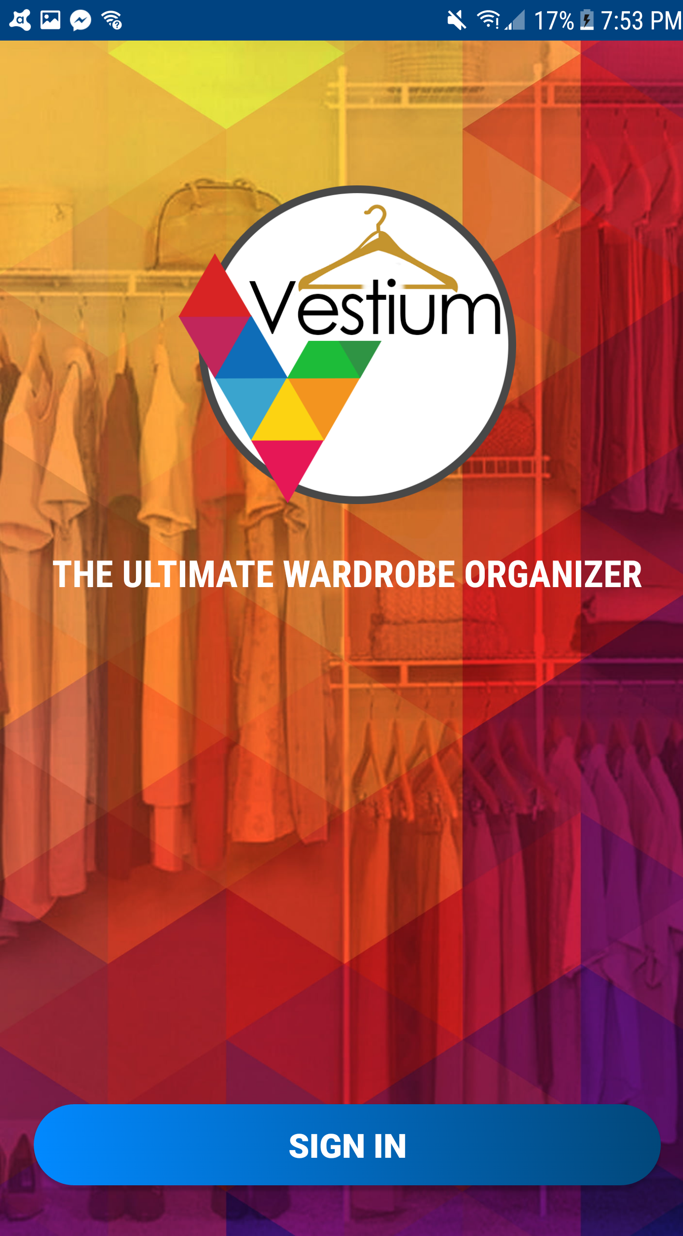
LOGIN SCREEN

Slide 4

SPLASH SCREEN

Slide 5
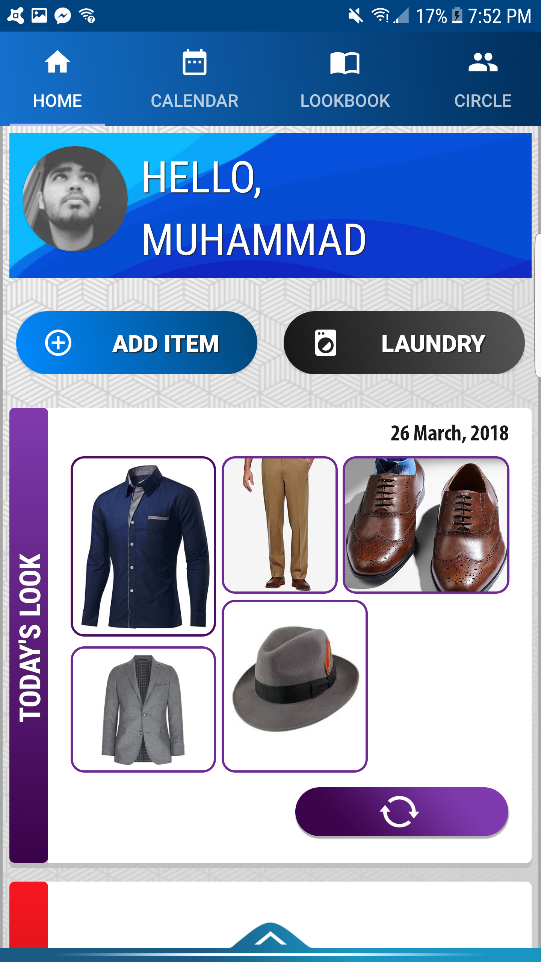
HOMESCREEN 1
Tab-Layout at the top
Contains a view-Pager with four fragment activities.
Users able to switch between activities by clicking on Tabs, or scrolling left/ right.
Welcome pane.
‘ADD ITEM’ and ‘LAUNDRY’ buttons.
ADD ITEM…

Slide 6
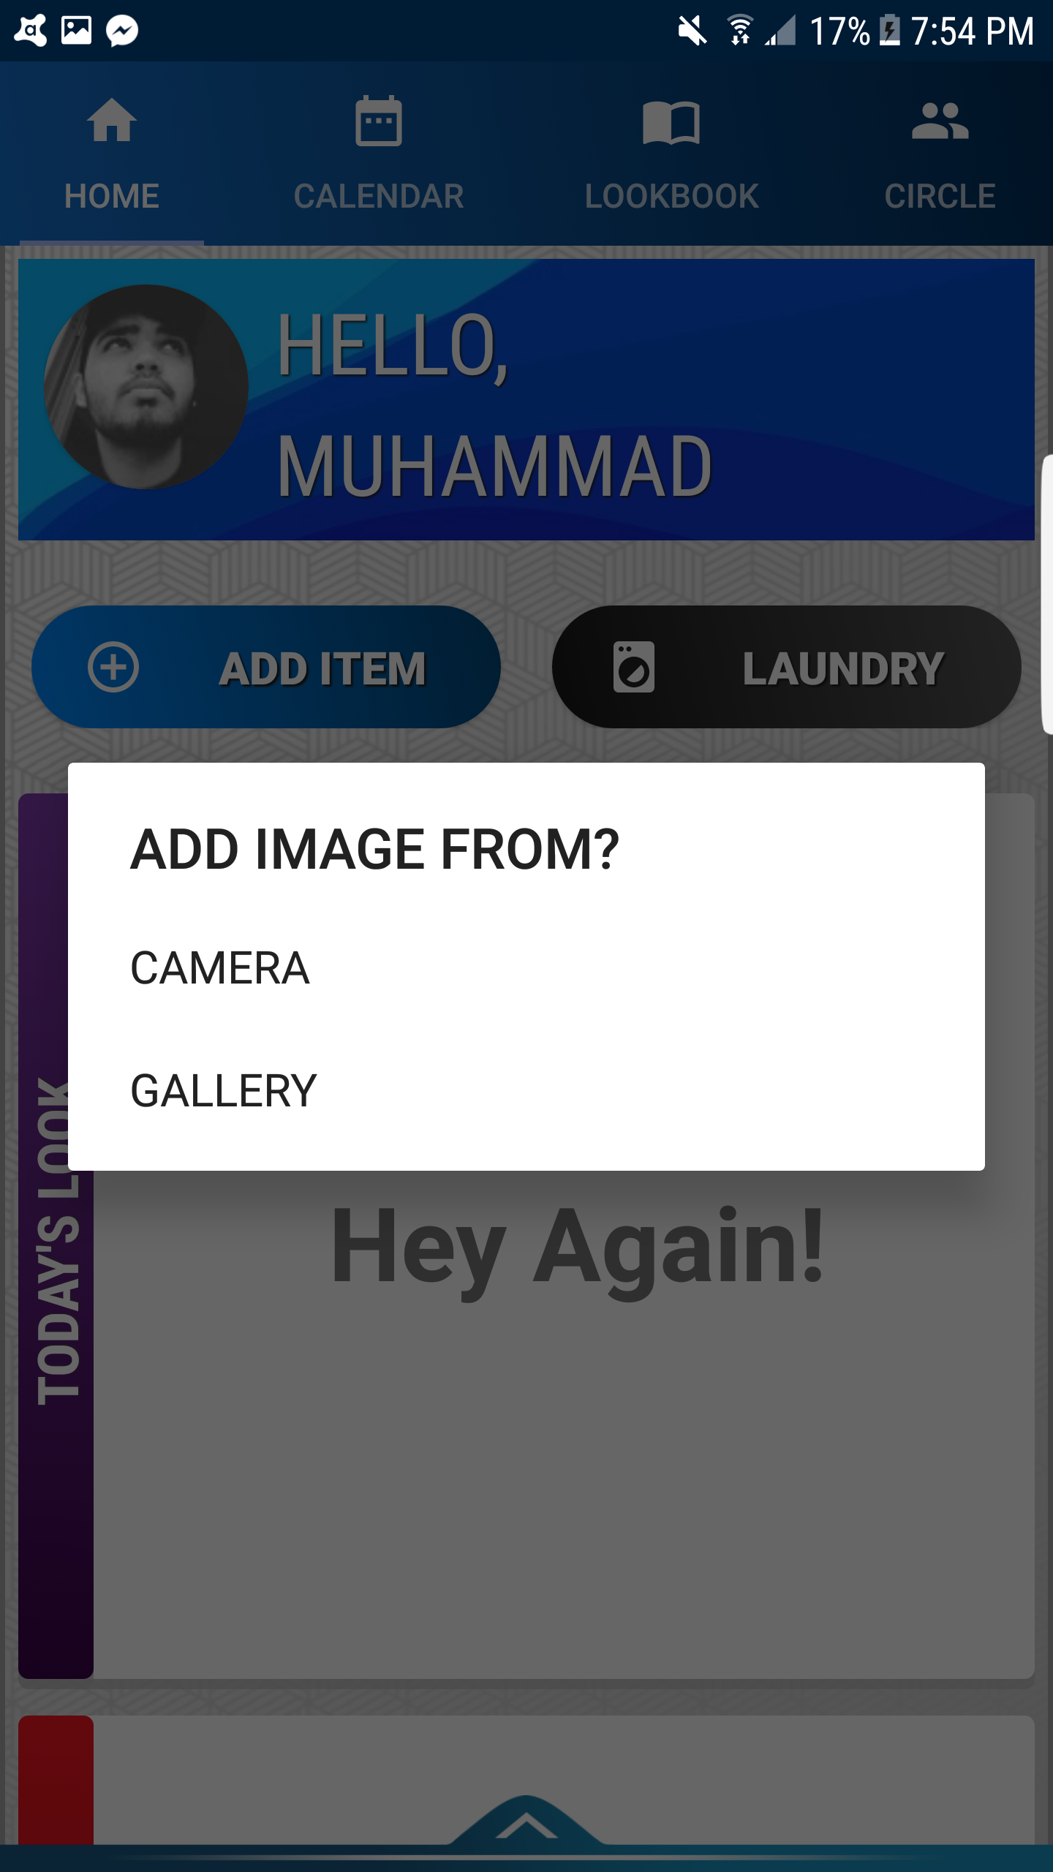
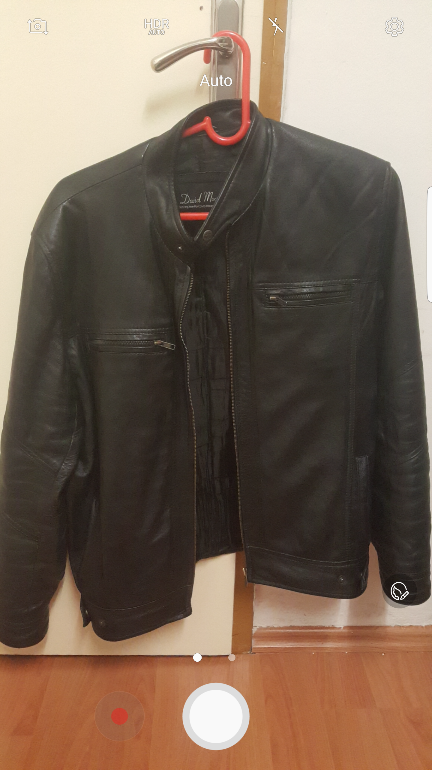
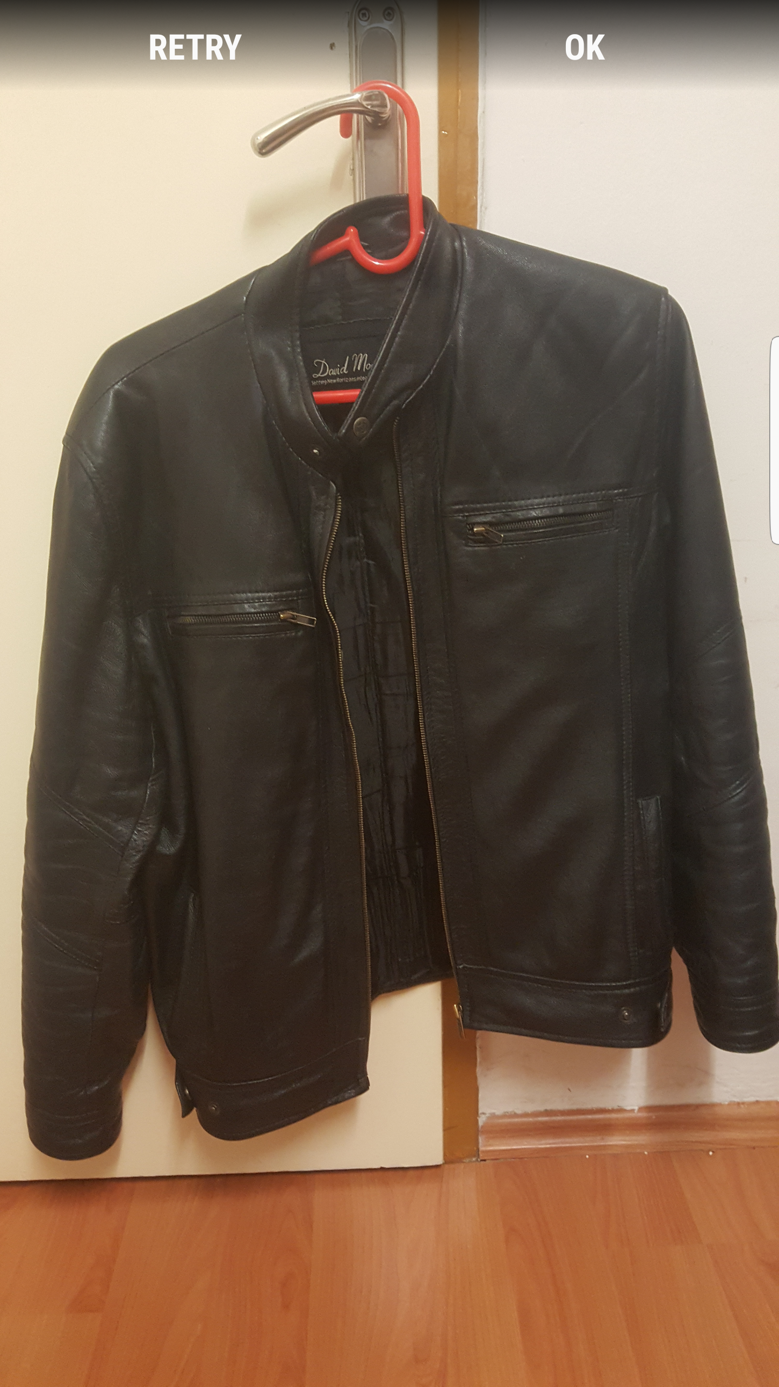
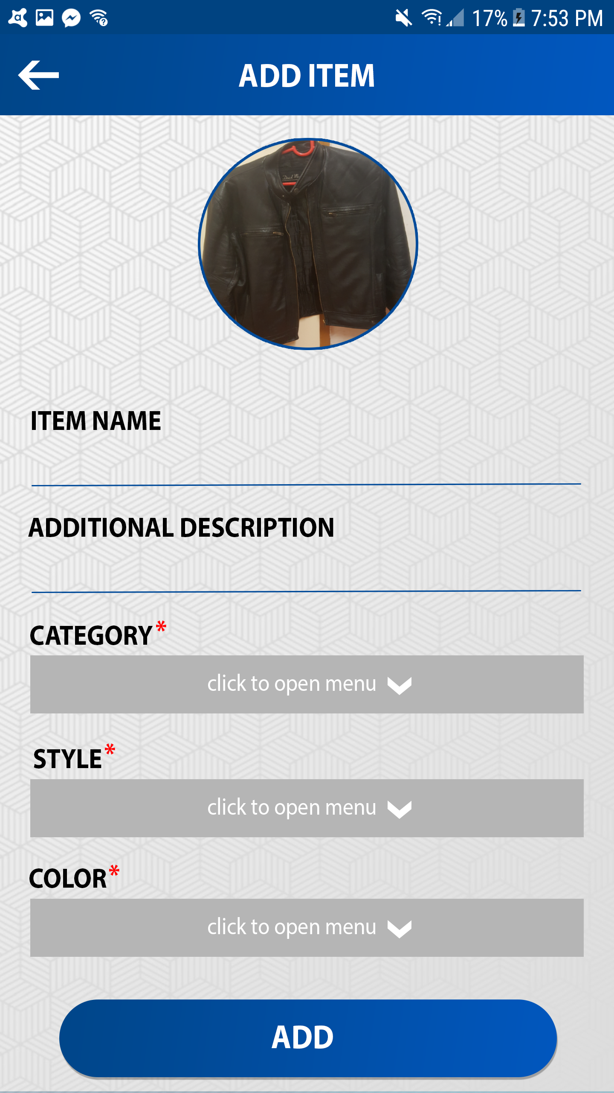
ADD ITEM

Slide 7
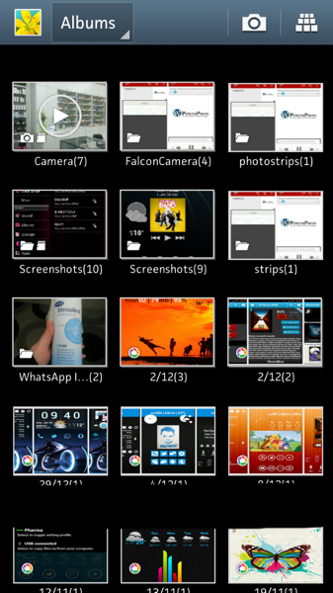
ADD ITEM

Slide 8
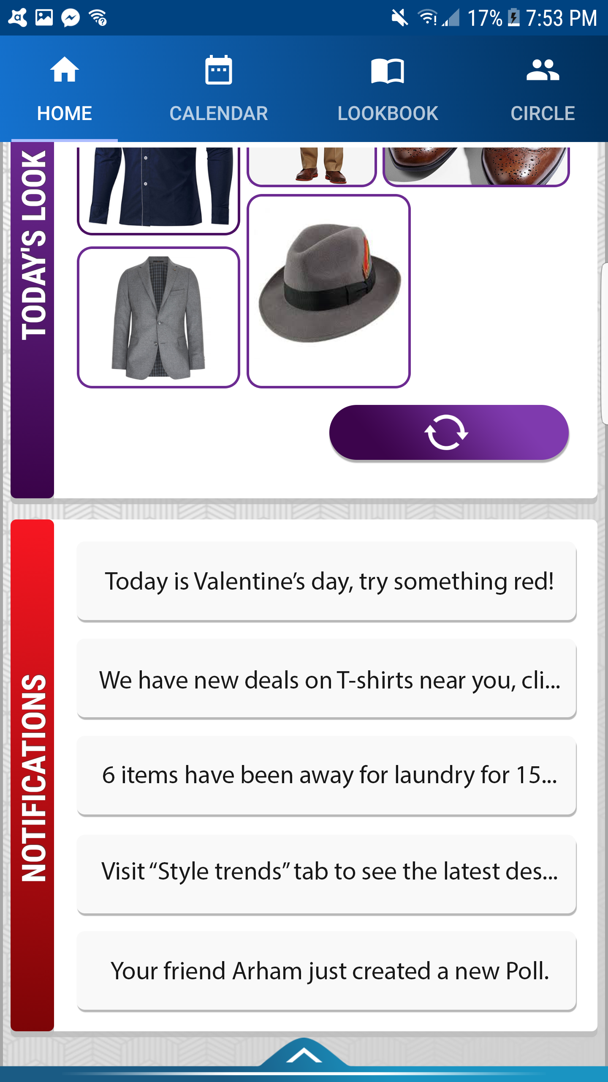
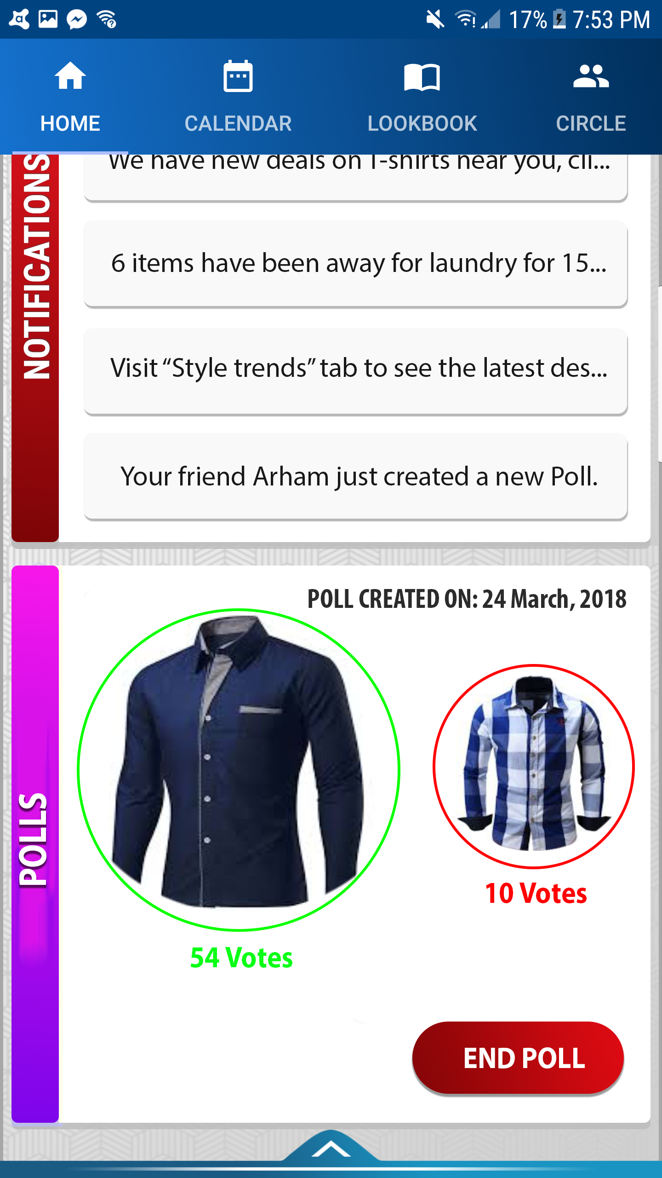
HOMESCREEN 2
Today’s Look pane.
Refresh Look Button.
Notifications pane.
‘Polls pane’.

Slide 9
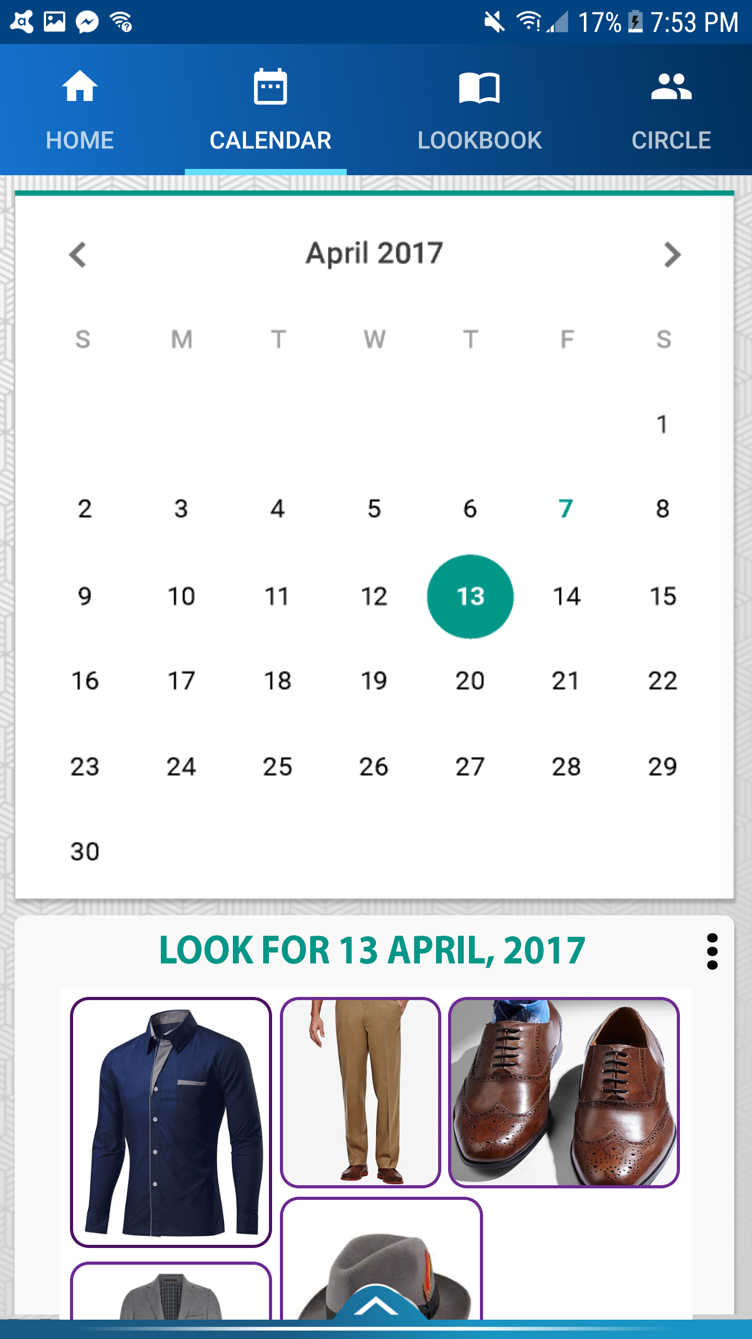
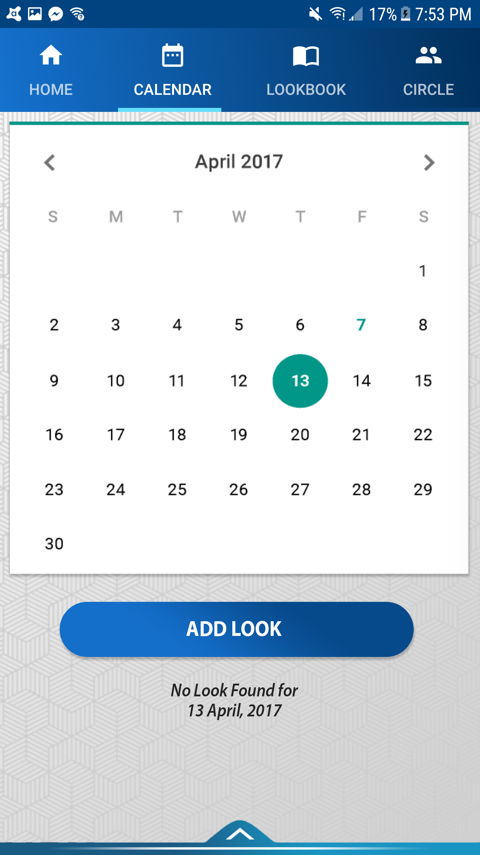
CALENDAR

Slide 10
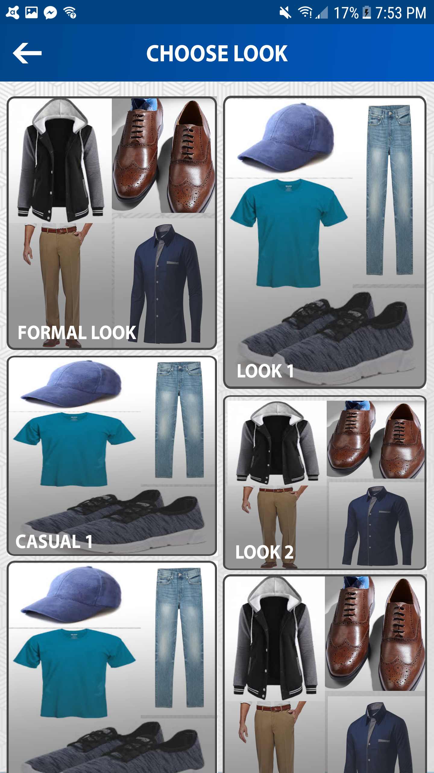
ADD LOOK IN CALENDAR

Slide 11
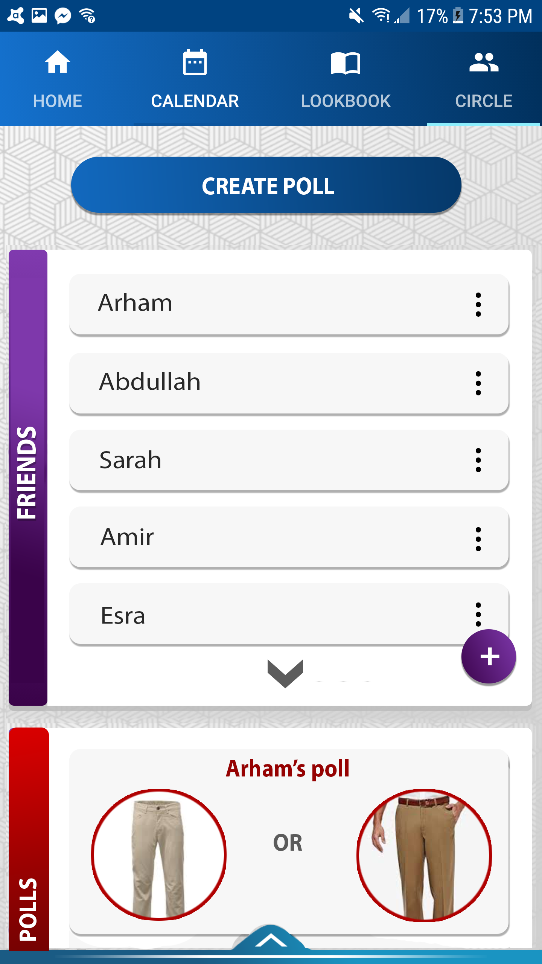
CIRCLES

Slide 12
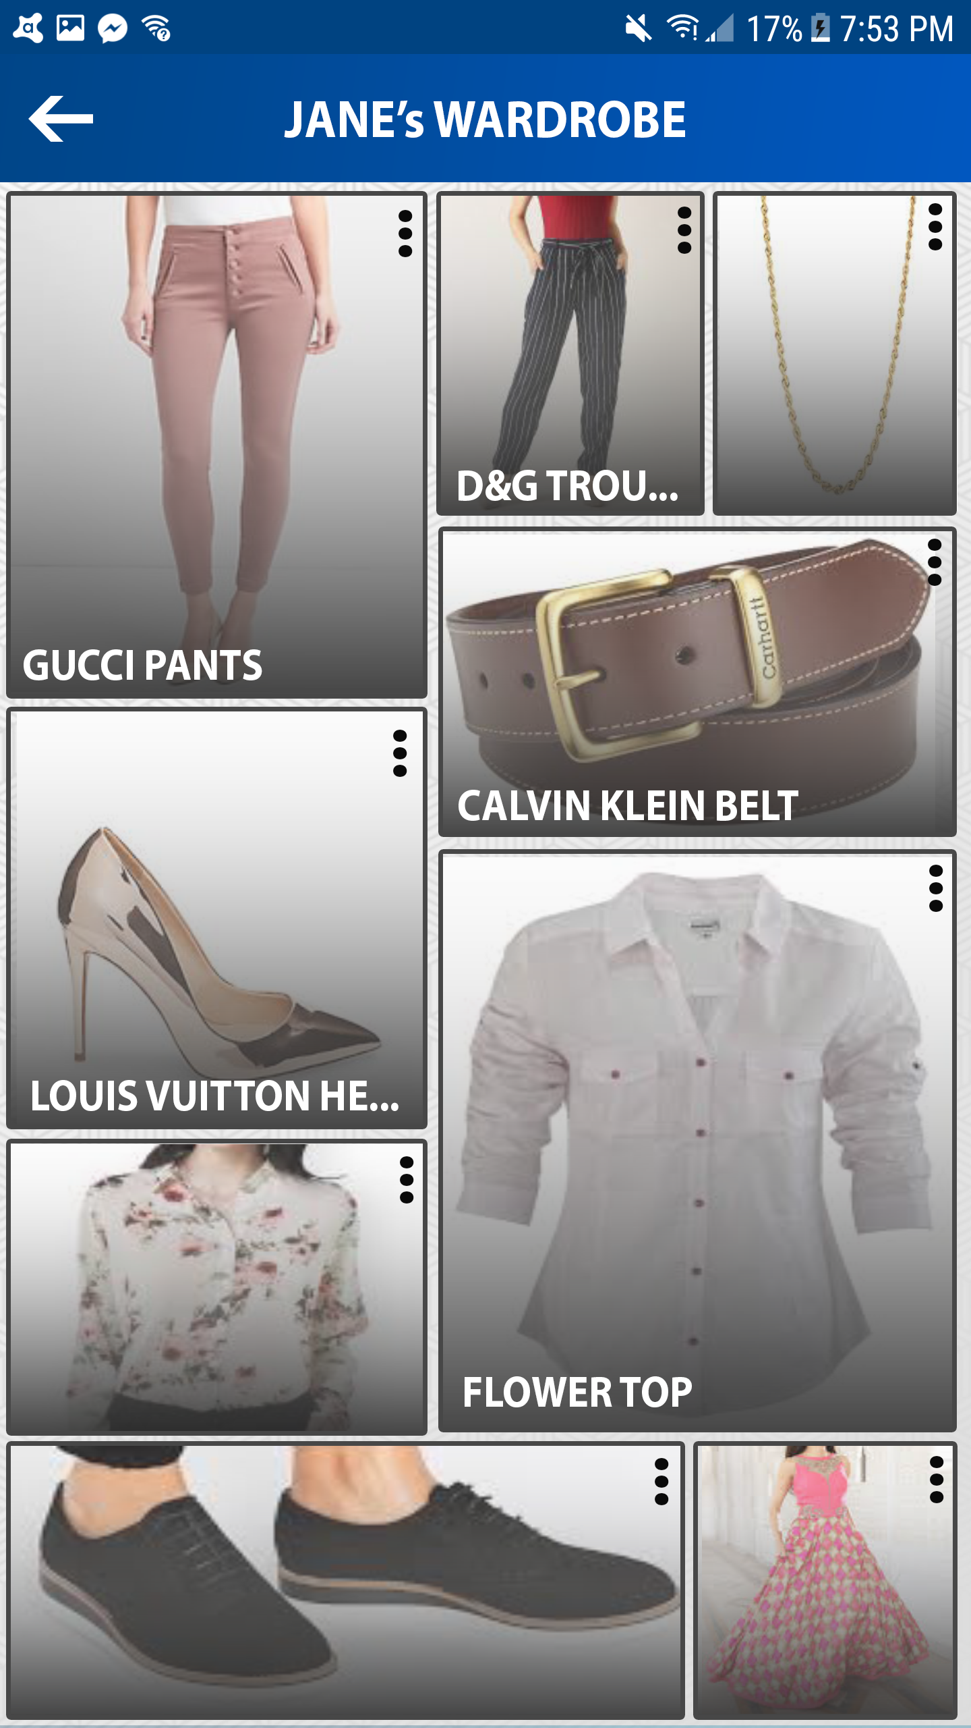
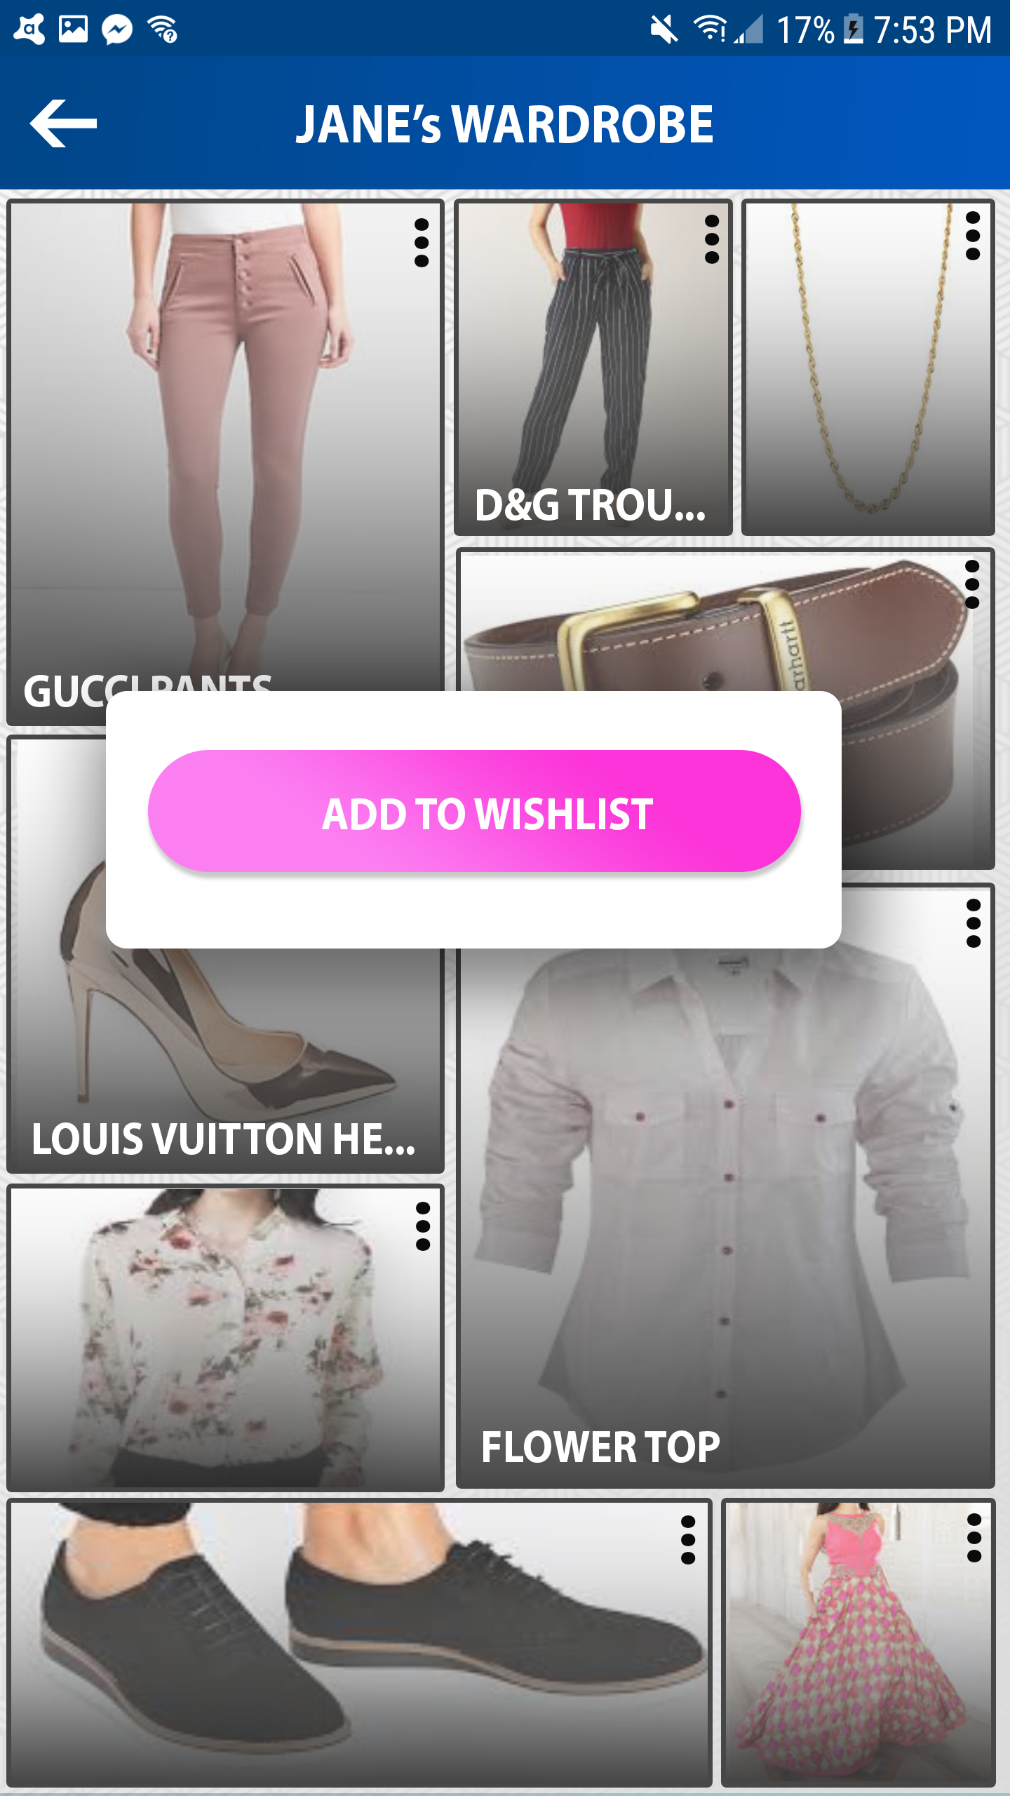
CIRCLES: friends wardrobe
View shared items from your friend’s wardrobes.
Add selected items to your wish-list

Slide 13
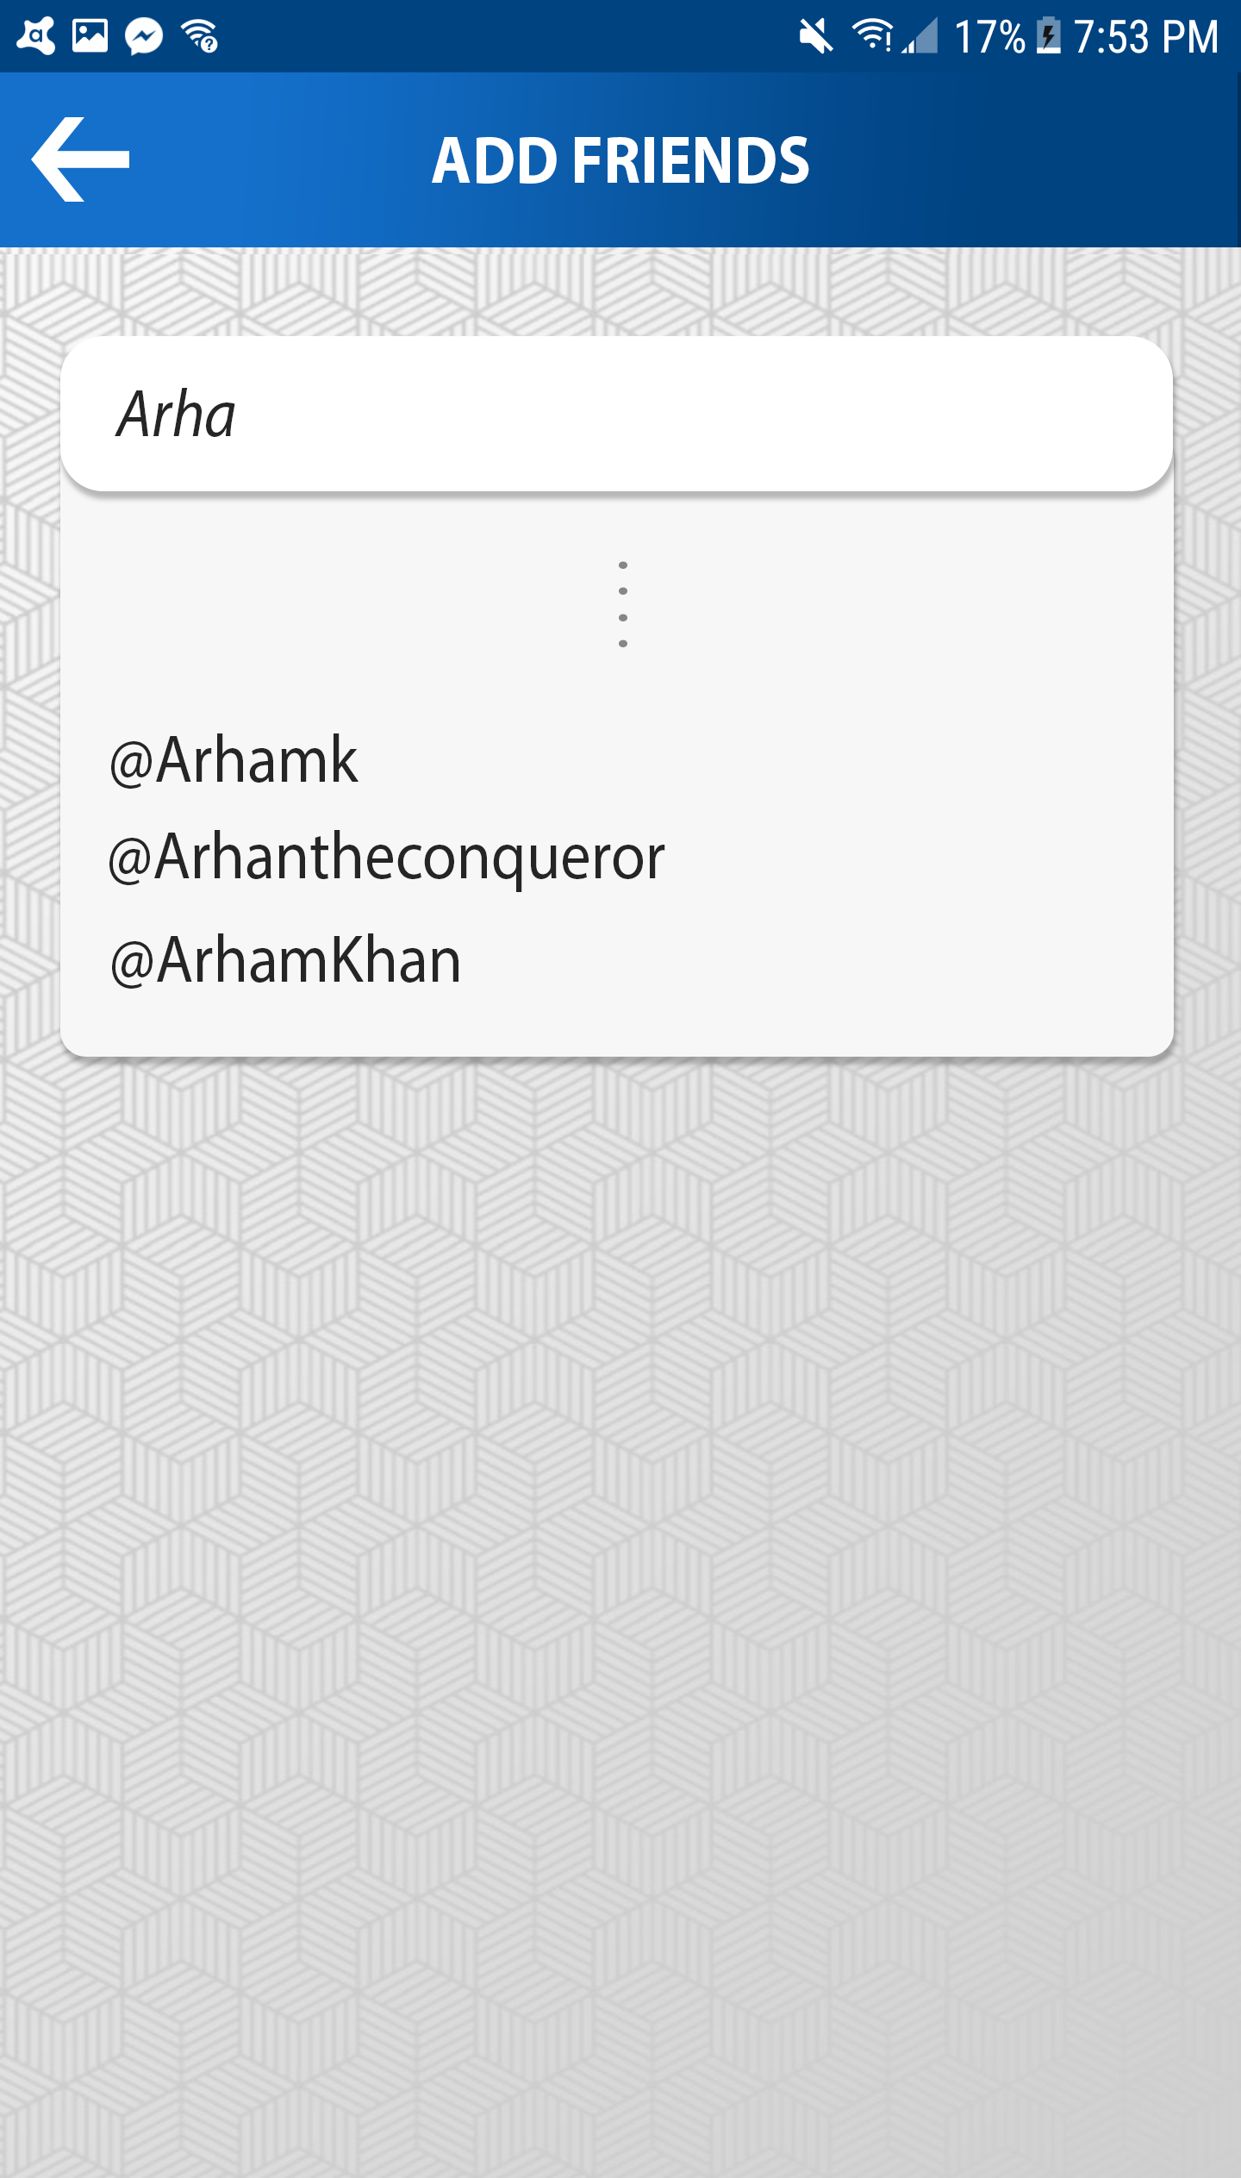
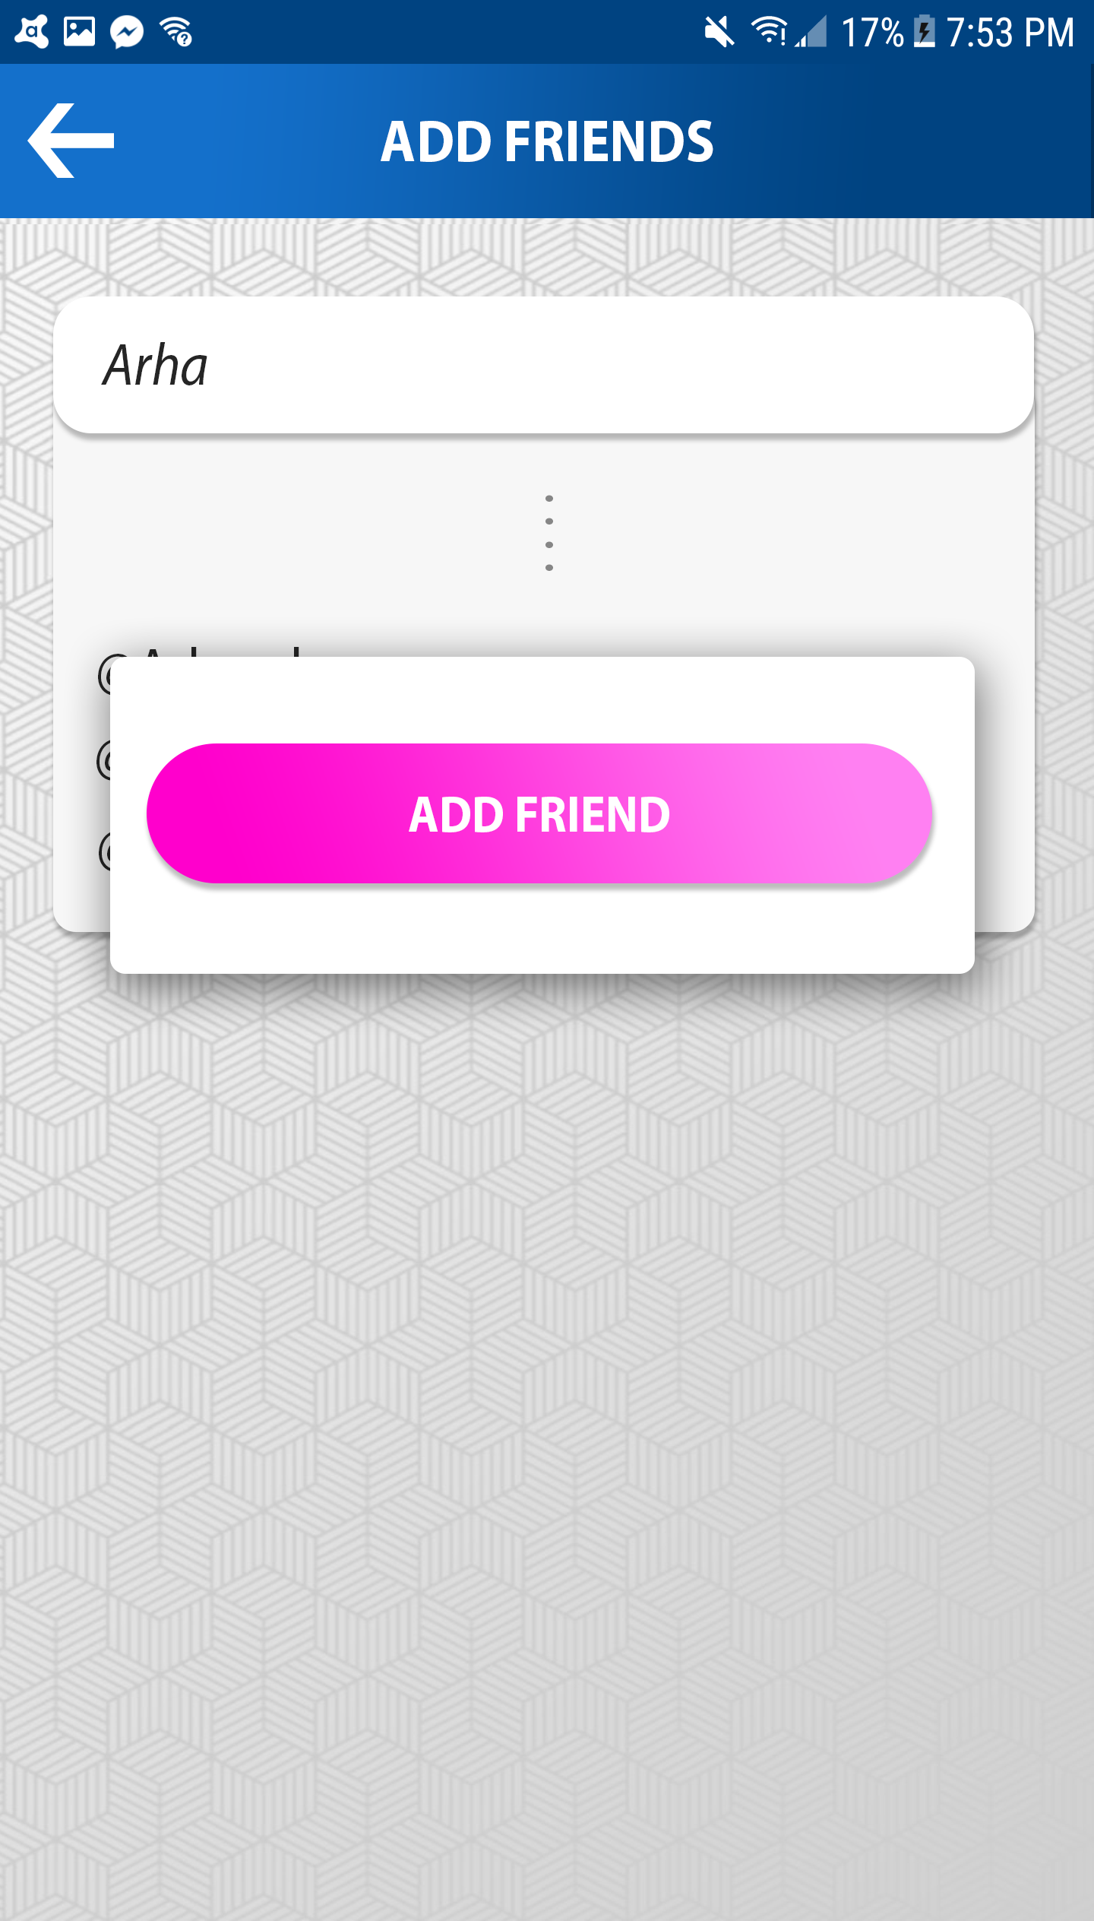
CIRCLES: ADD FRIENDS

Slide 14
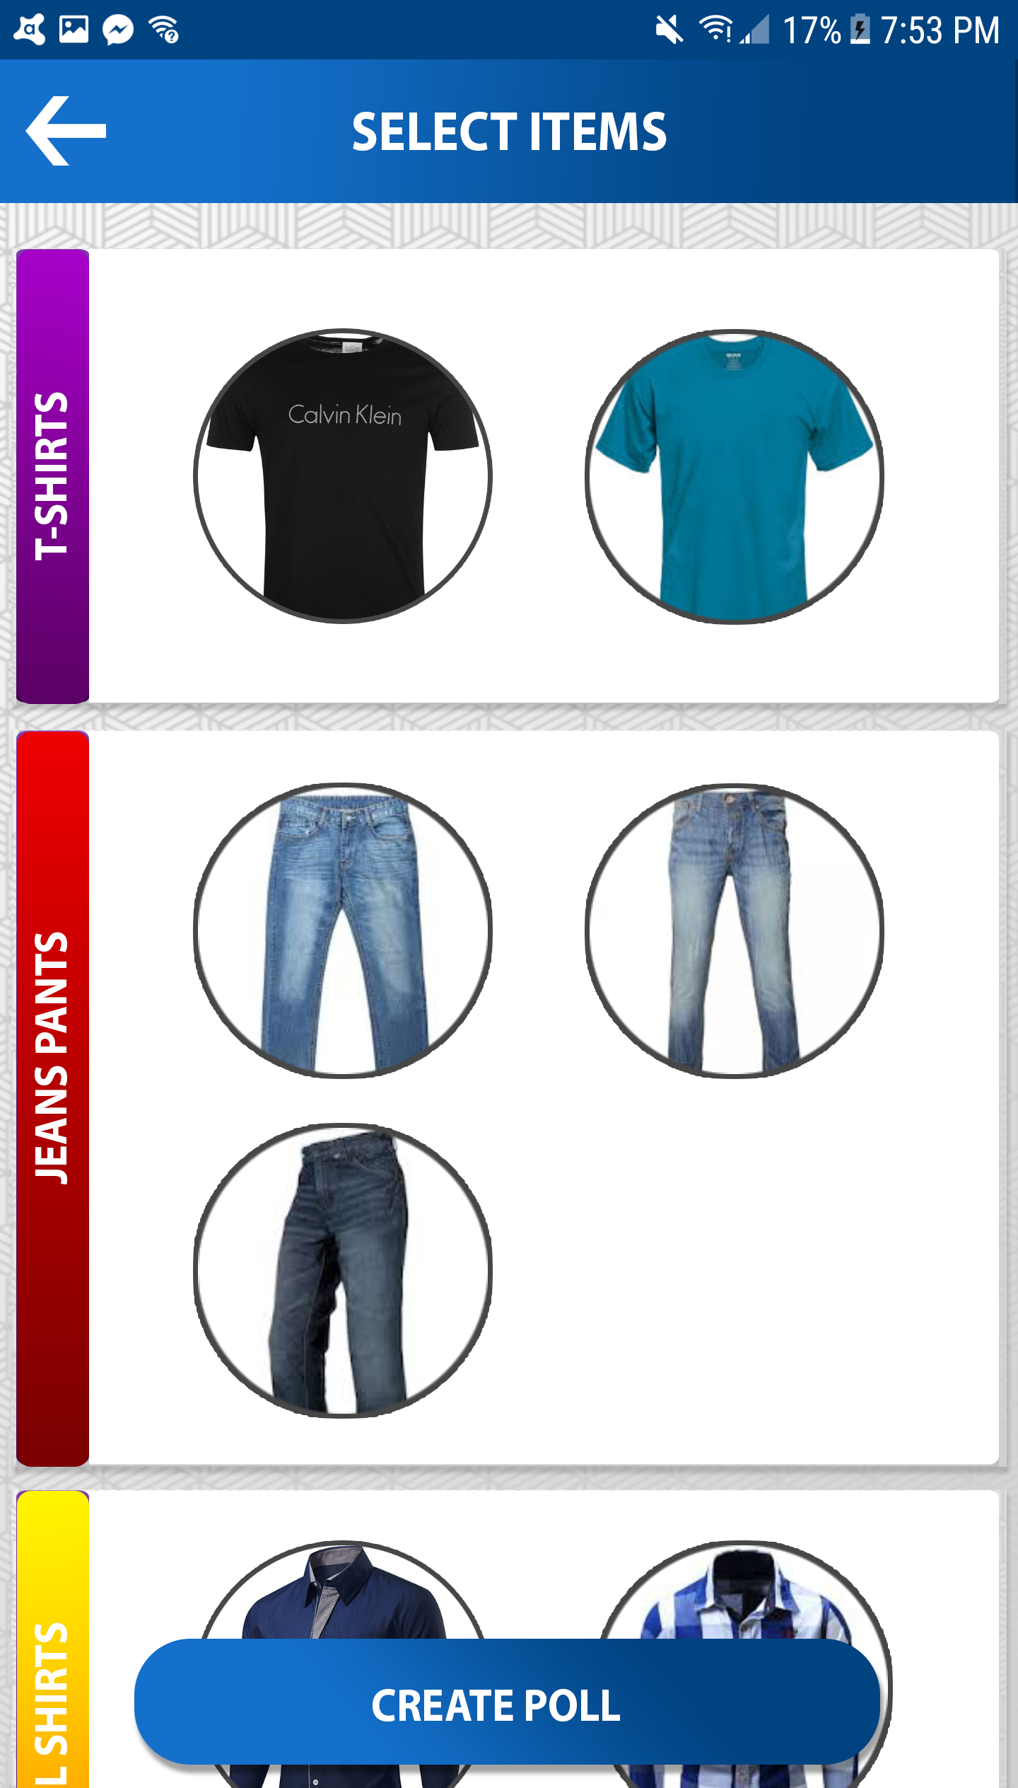
CIRCLES: CREATE POLL

Slide 15
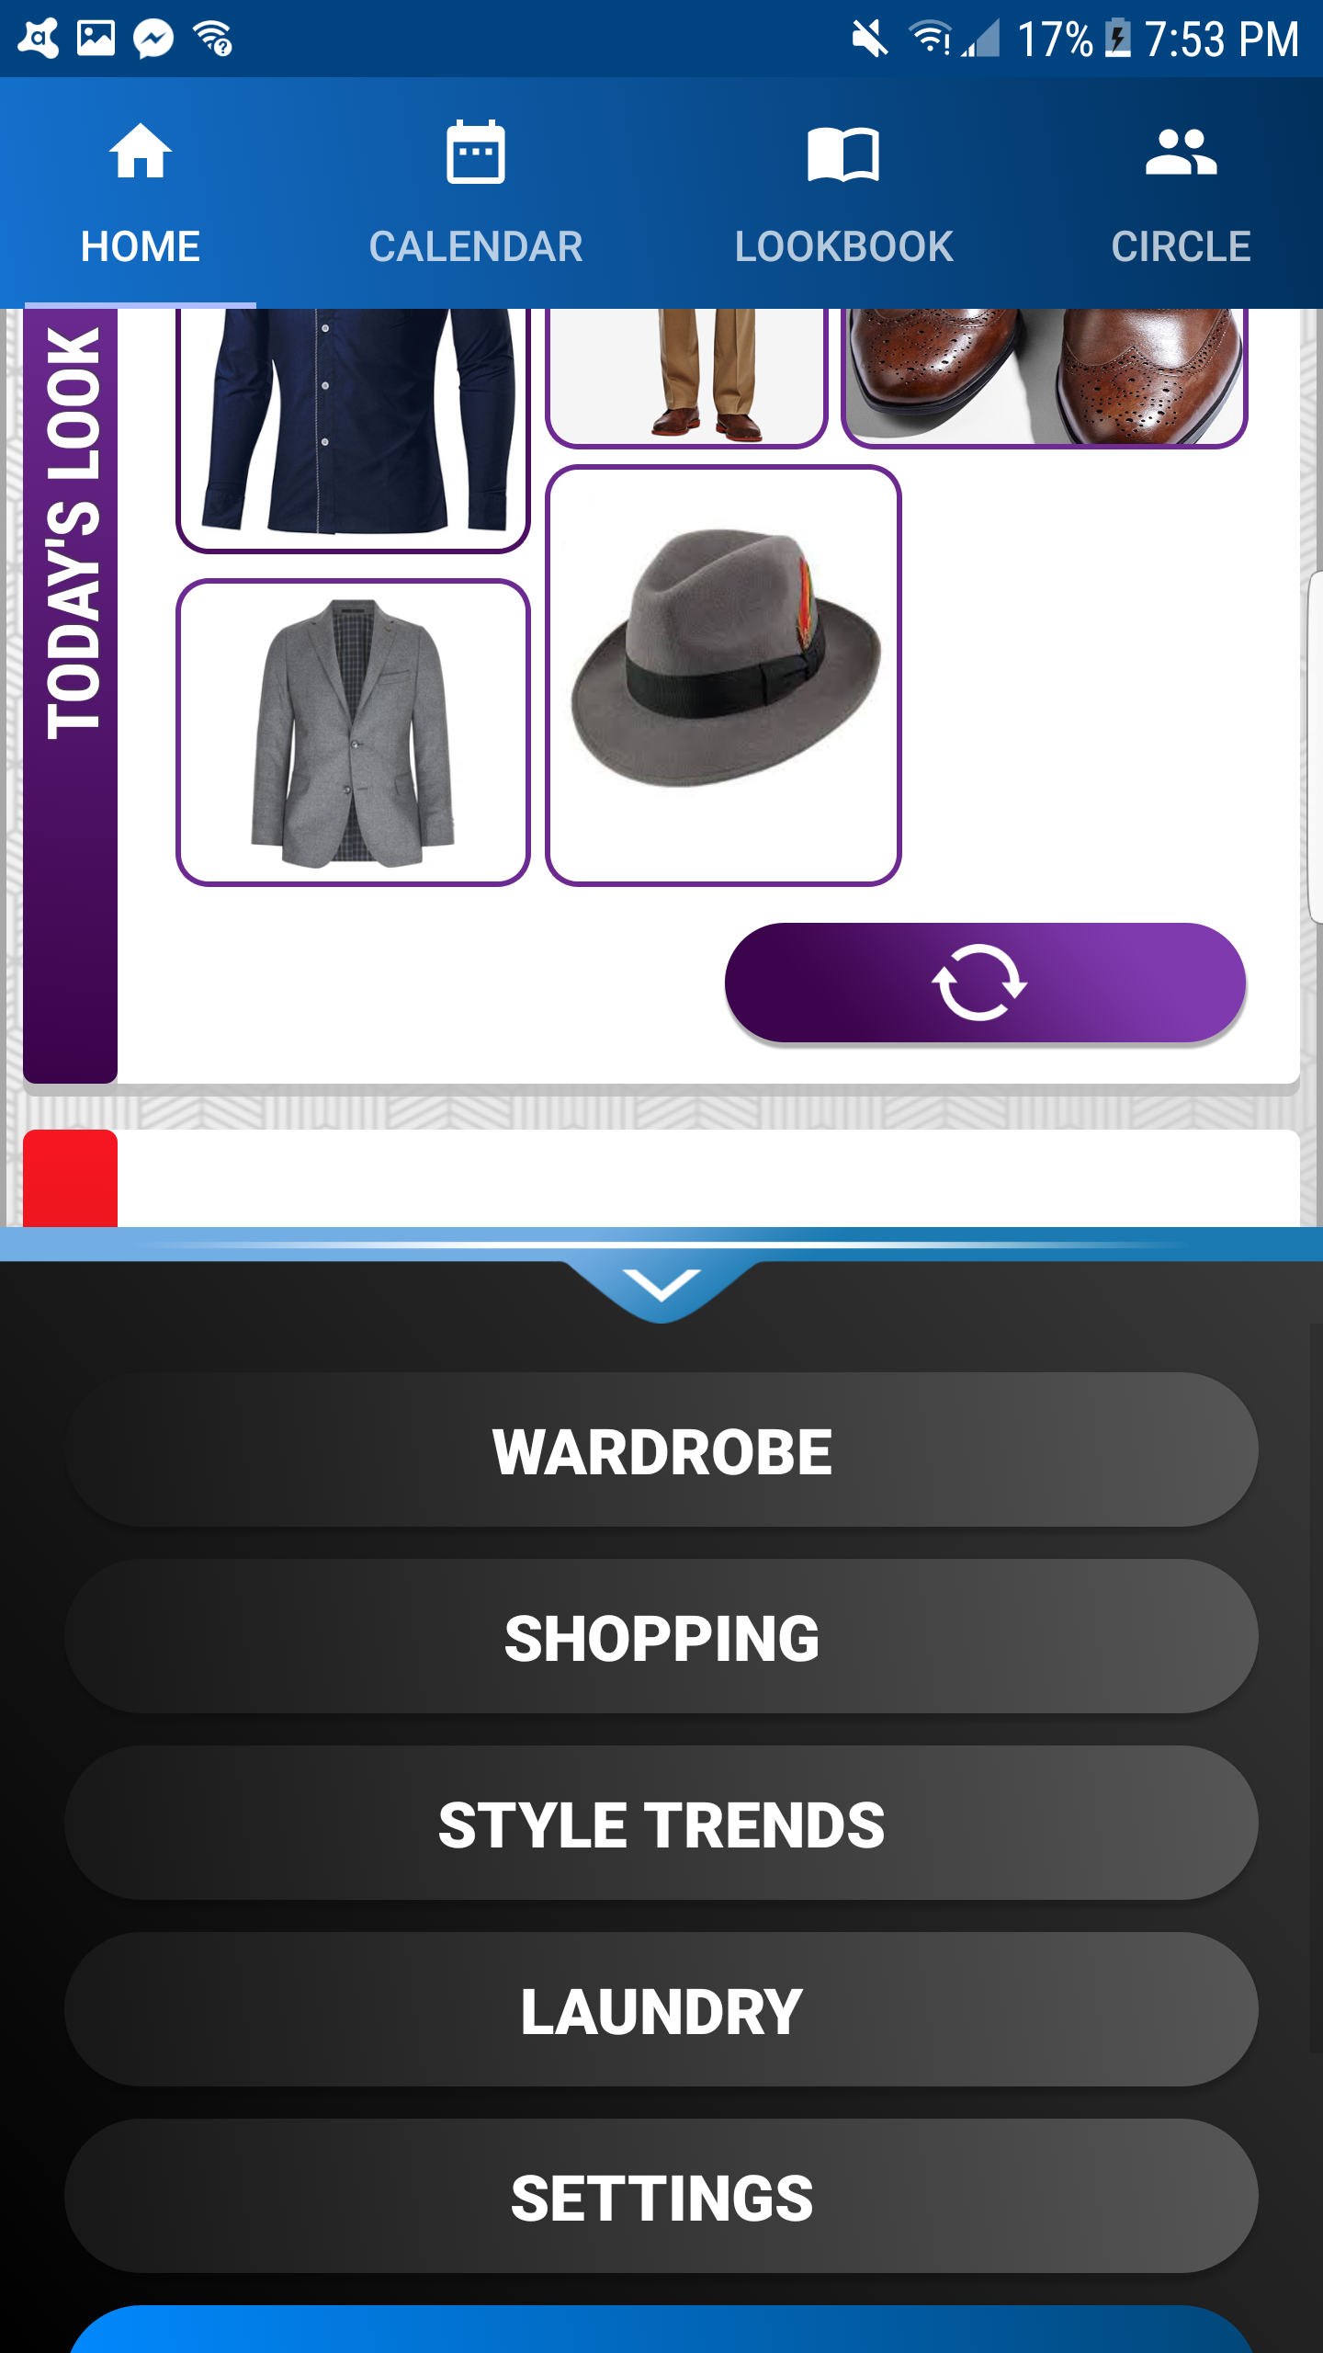
MAIN MENU
Appears by clicking the arrow button at the bottom of home-screen.
Scrollable. Disappears after 5 seconds of inactivity or upon clicking the arrow-down button
Contains buttons to all the features of Vestium.
Also contains “LOGOUT” “button.

Slide 16
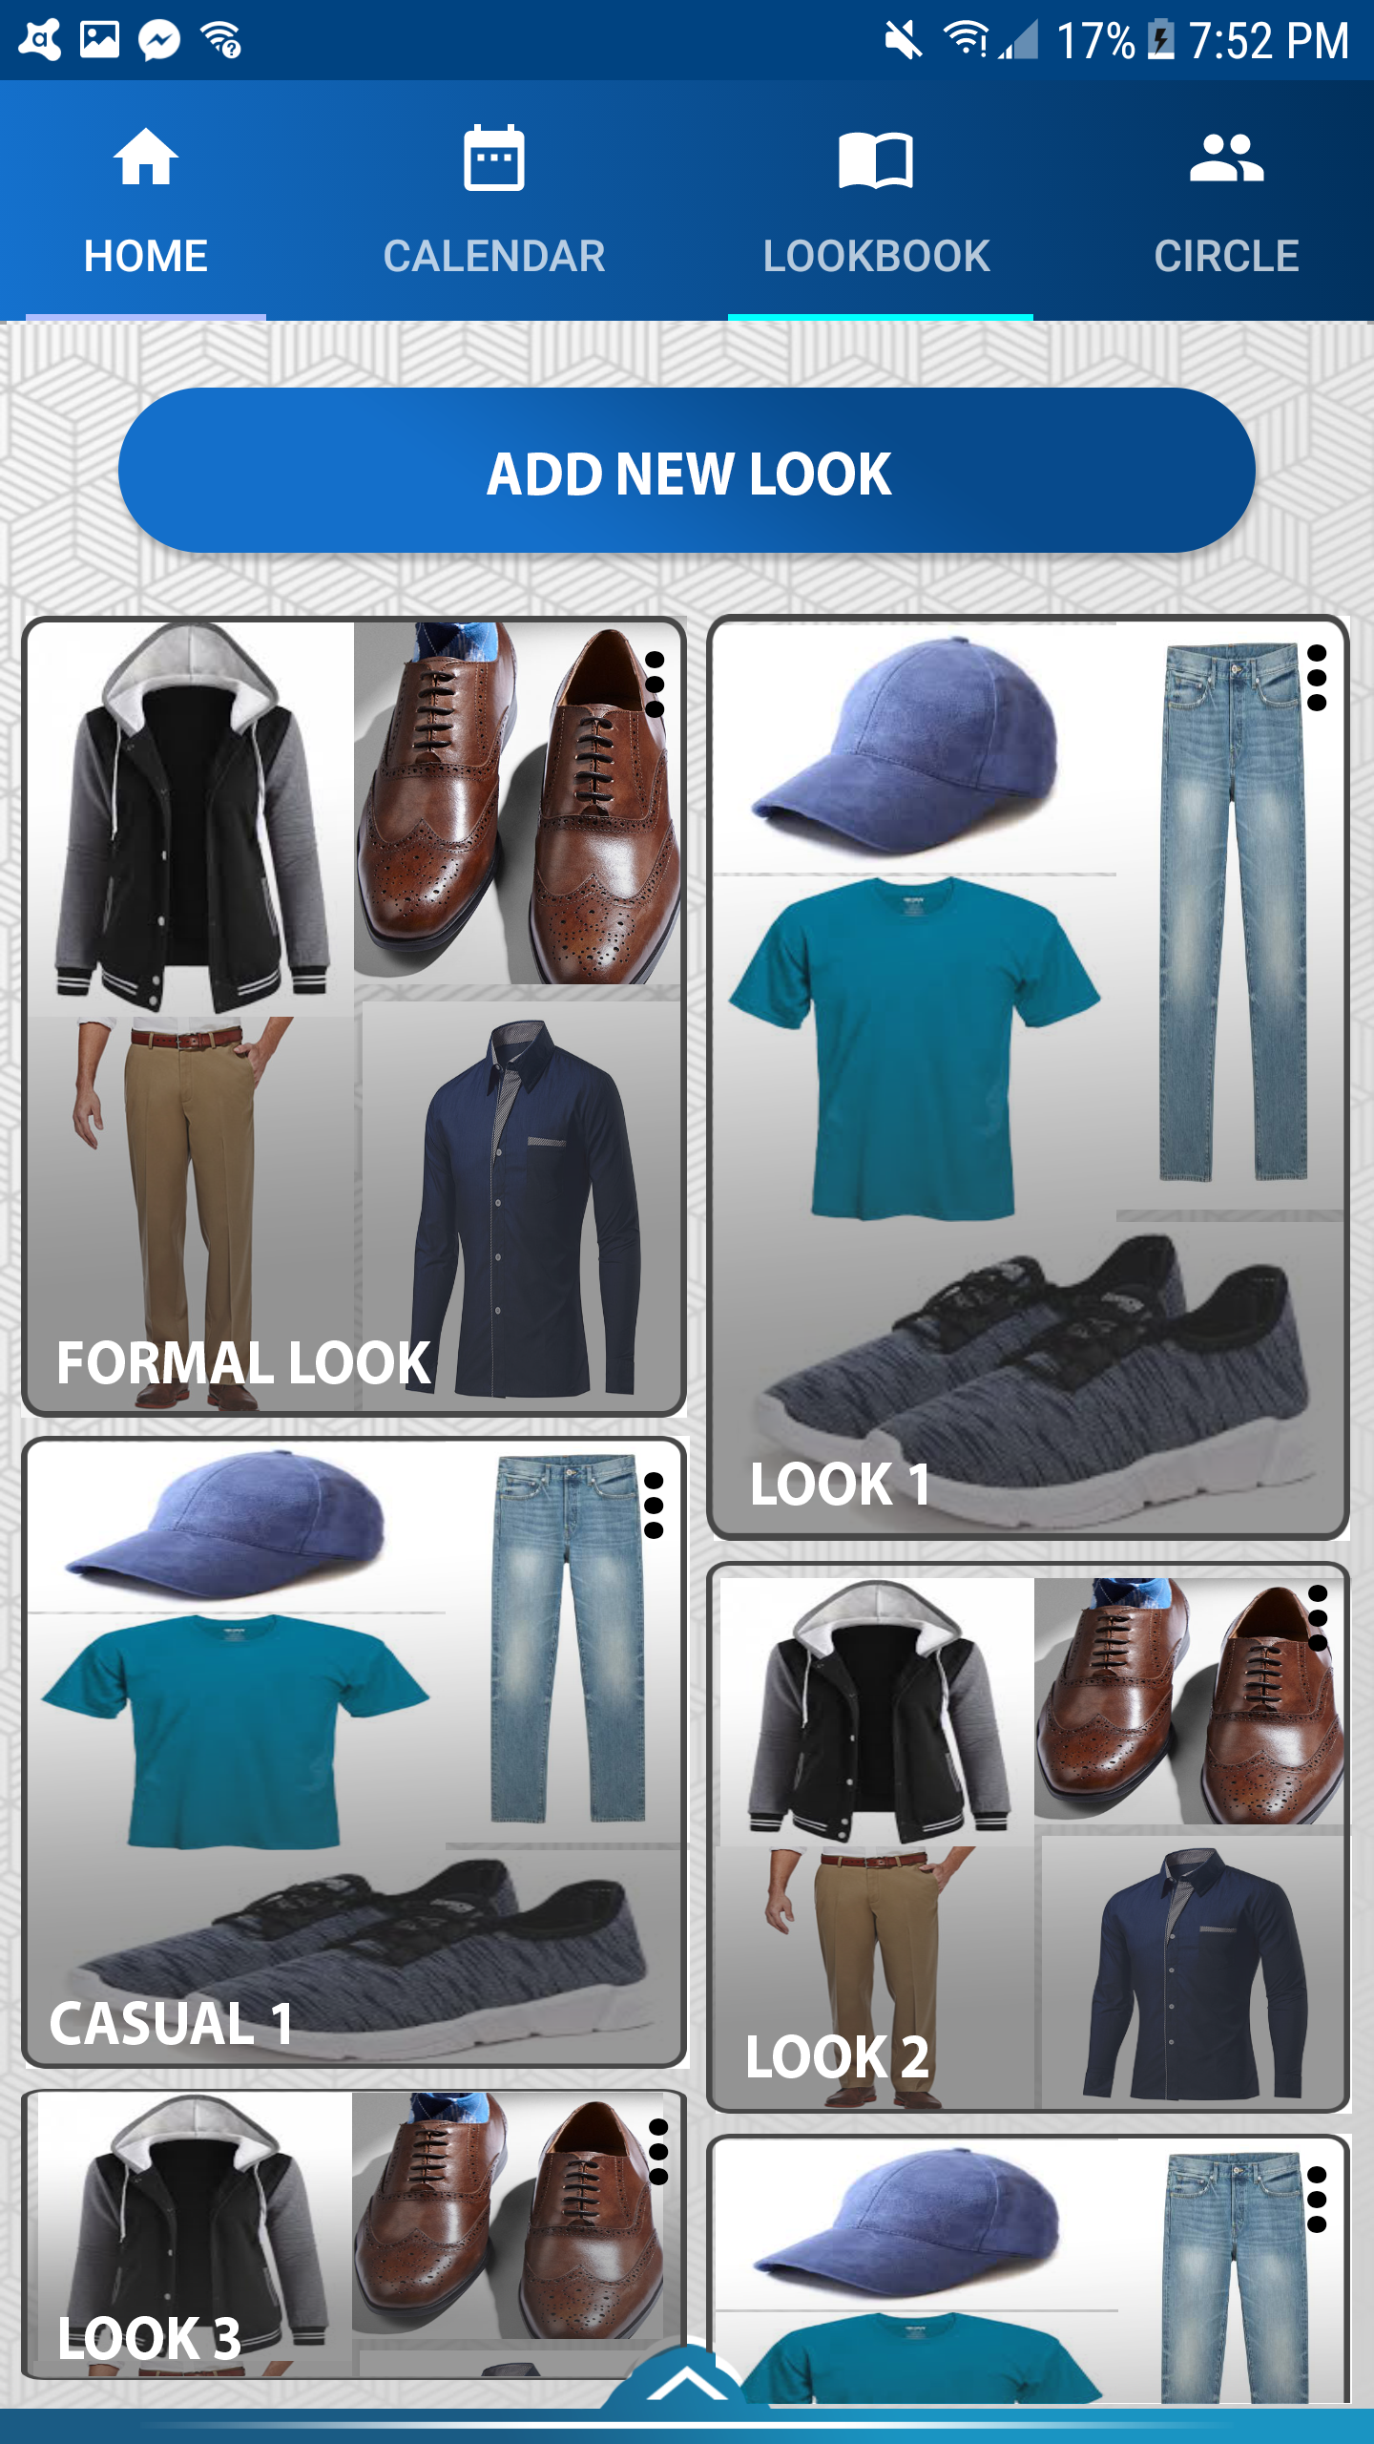
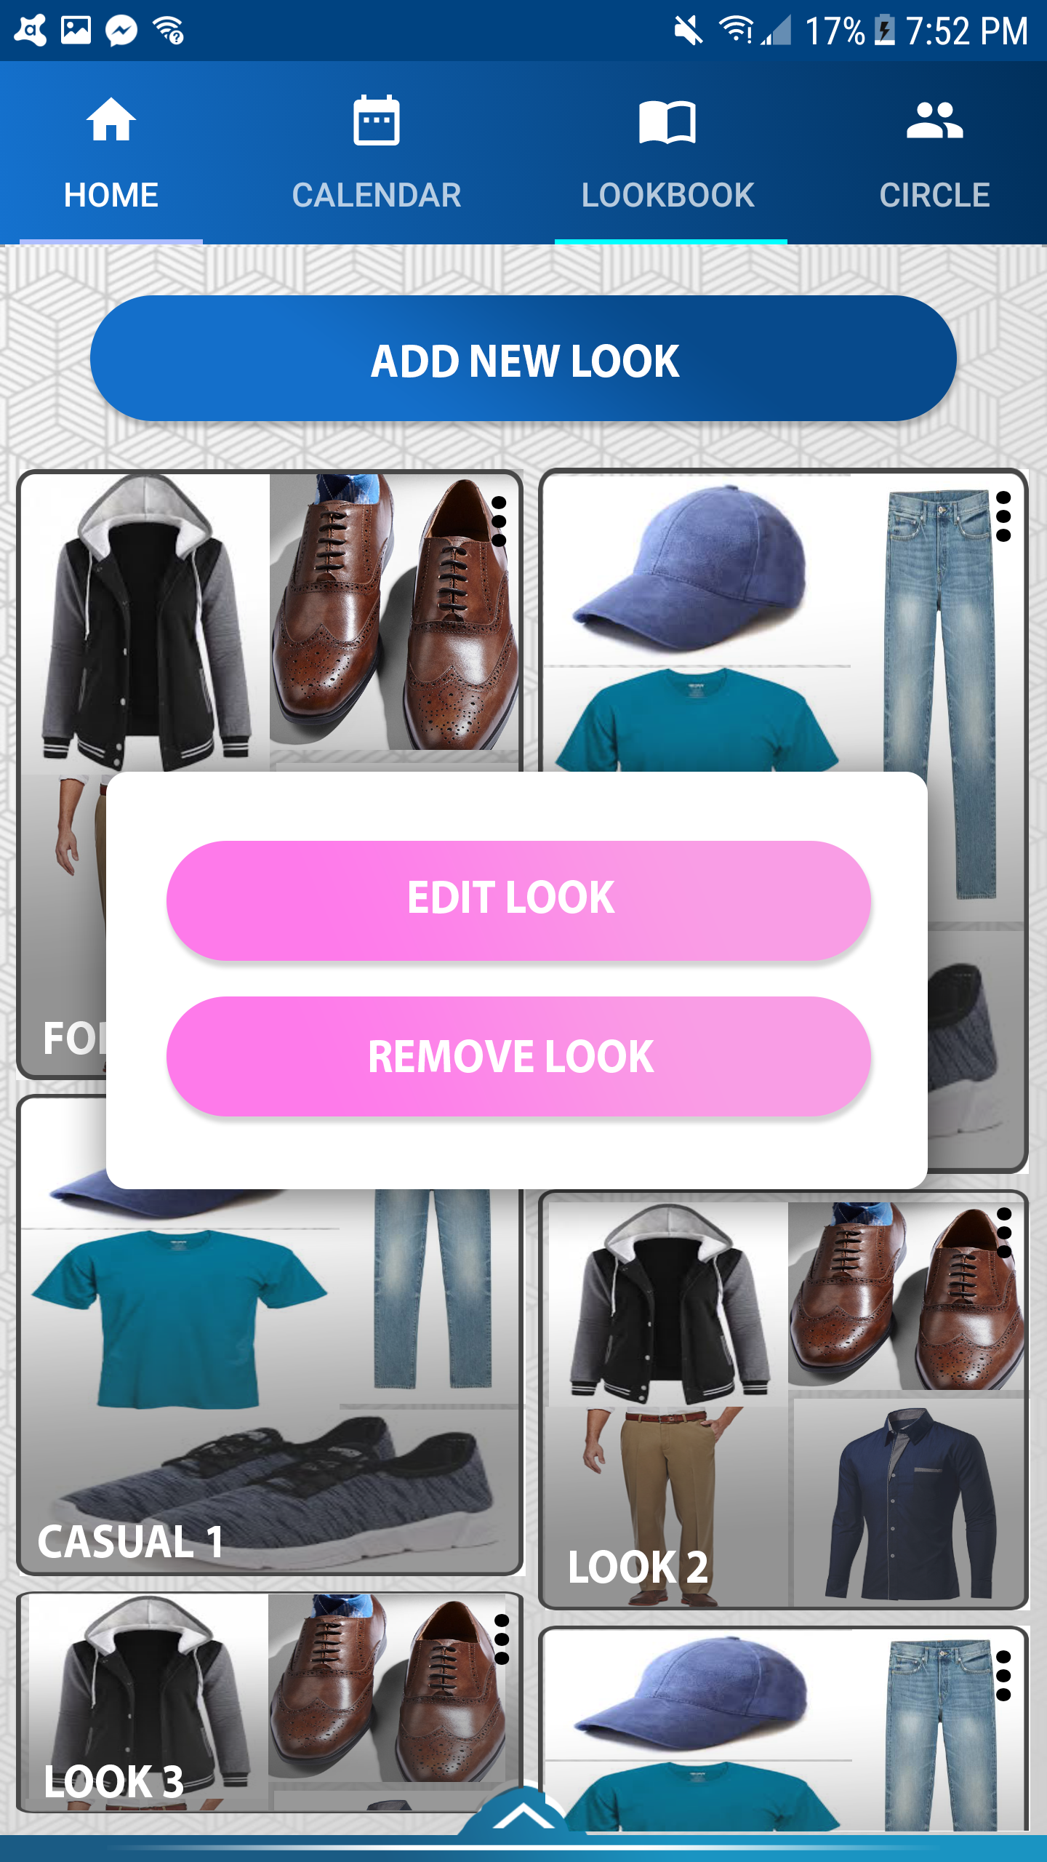

LOOKBOOK
A fragment activity accessible through the home-screen tabs.
Allows user to create new outfit combinations from their wardrobe by clicking on “ADD NEW LOOK”.
Displays available looks in an infinite-scroll manner
Every look has a “…” menu button, that allows user to ‘EDIT’ or ‘REMOVE’ the menu.

Slide 17
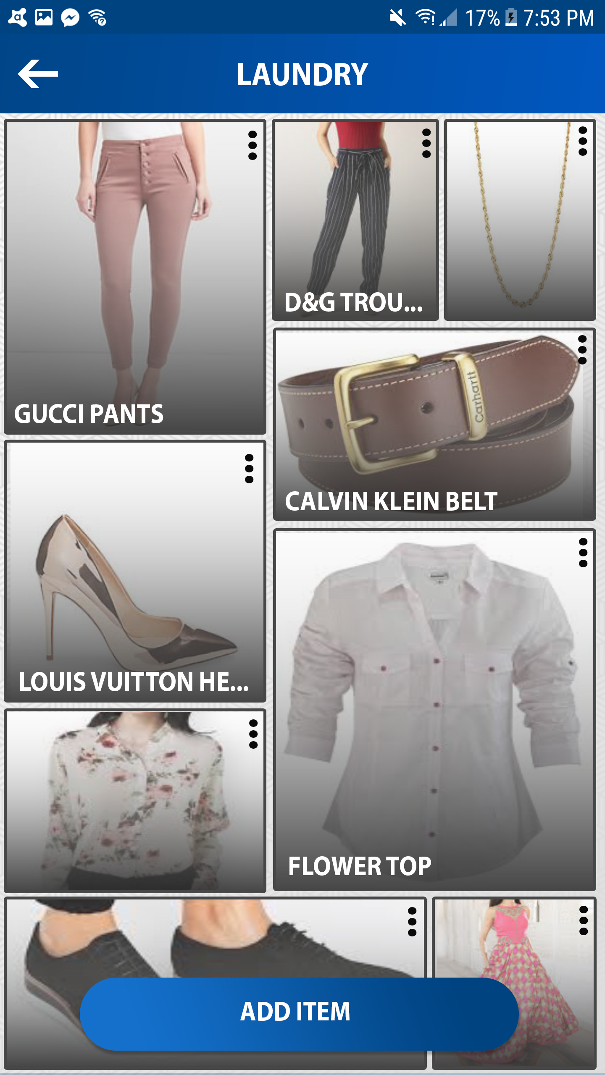
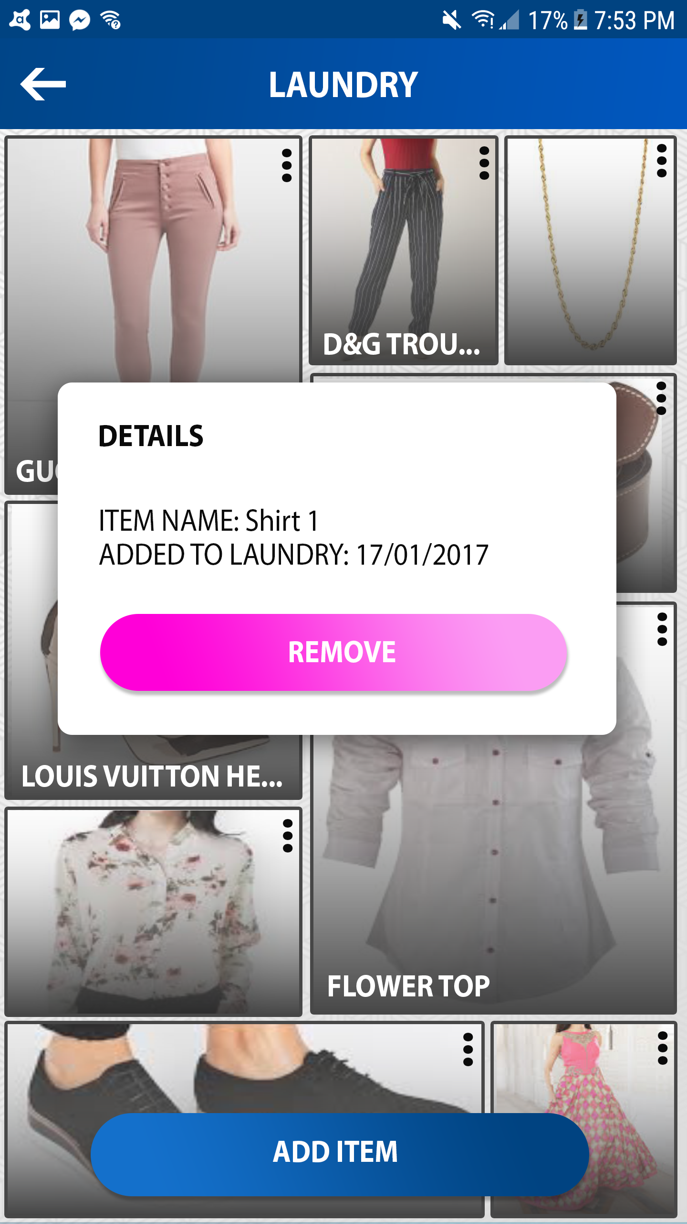

LAUNDRY
A new child activity, with a back-arrow button to return to home-screen
Displays images and titles of items in the laundry in an infinite-scroll manner.
Button to ‘’ADD NEW ITEM” to laundry.
Clicking this redirects you to wardrobe screen to select items.
“…” button on each item allows you to see info about it, or “REMOVE” the item from laundry.

Slide 18
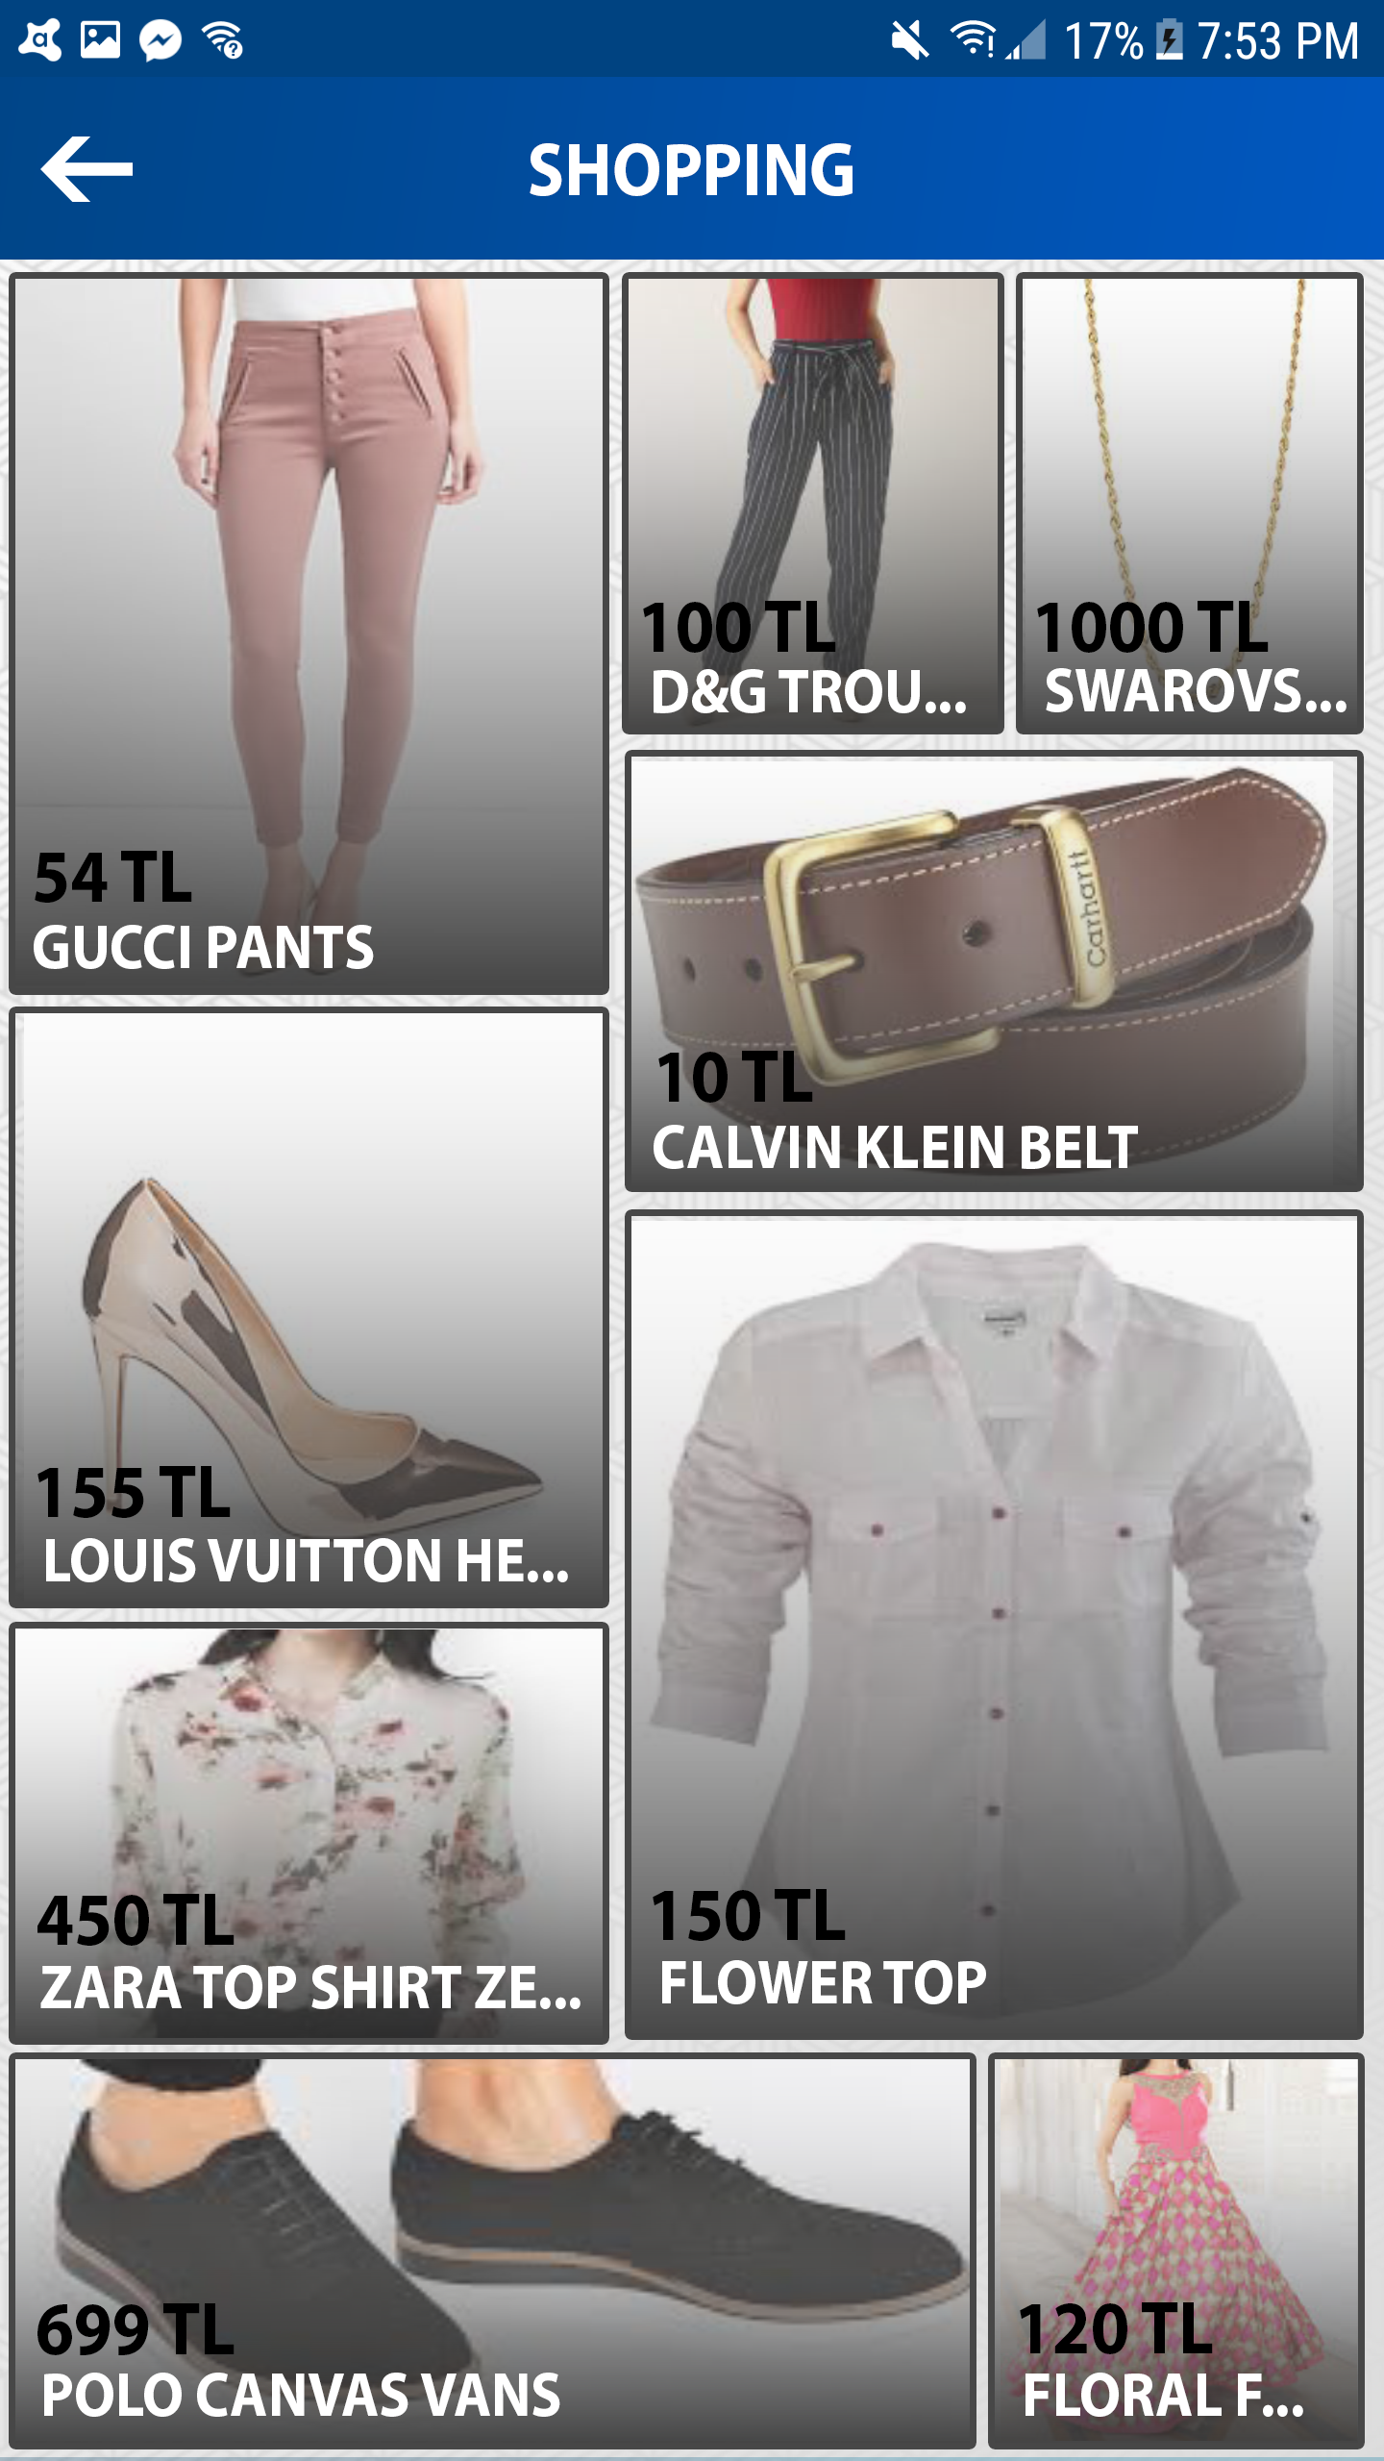
SHOPPING
A new child activity, with a back-arrow button to return to home-screen
Displays images, price and names of items in an infinite-scroll manner
Upon clicking an item, user redirected to the items webpage.

Slide 19
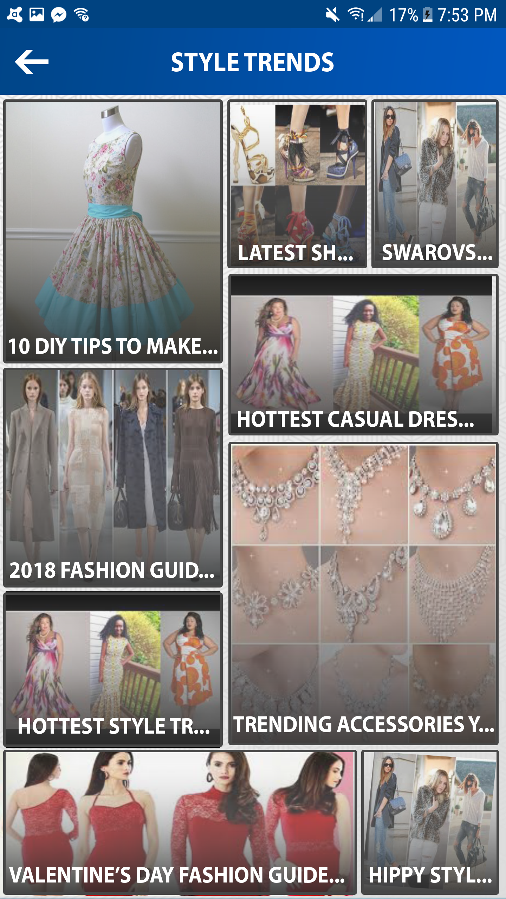
STYLE TRENDS
A new child activity, with a back-arrow button to return to home-screen
Displays thumbnails and article titles from reputed fashion websites in an infinite-scroll manner
Upon clicking an item, user redirected to the article.

Slide 20
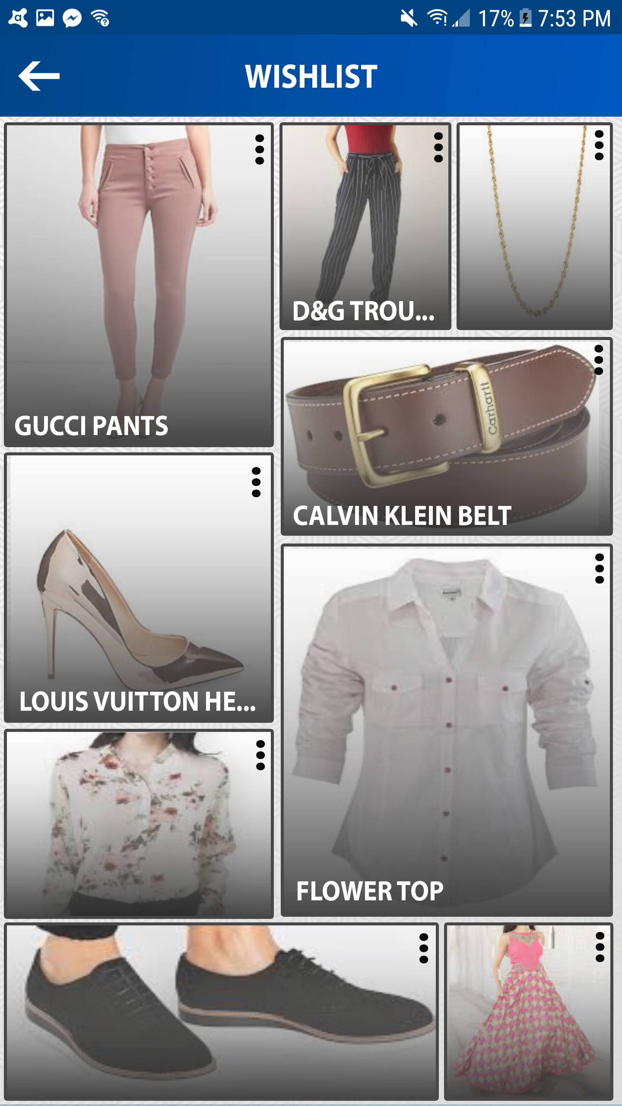
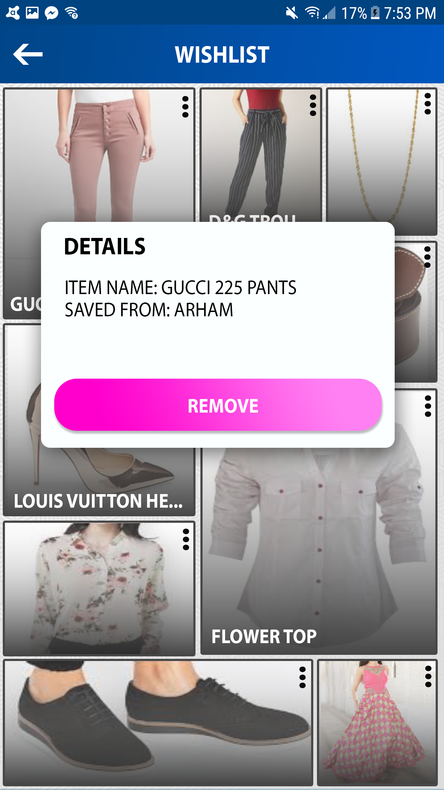
WISHLIST

Slide 21
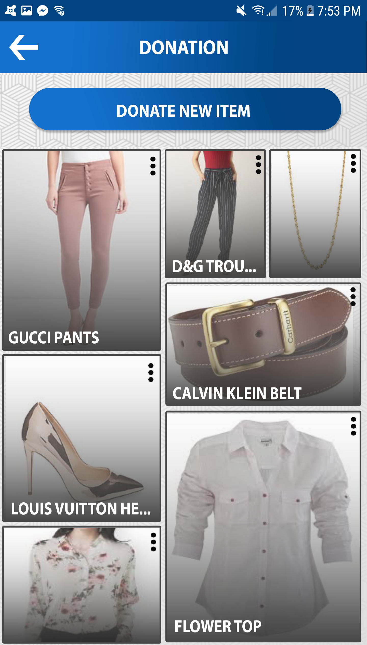
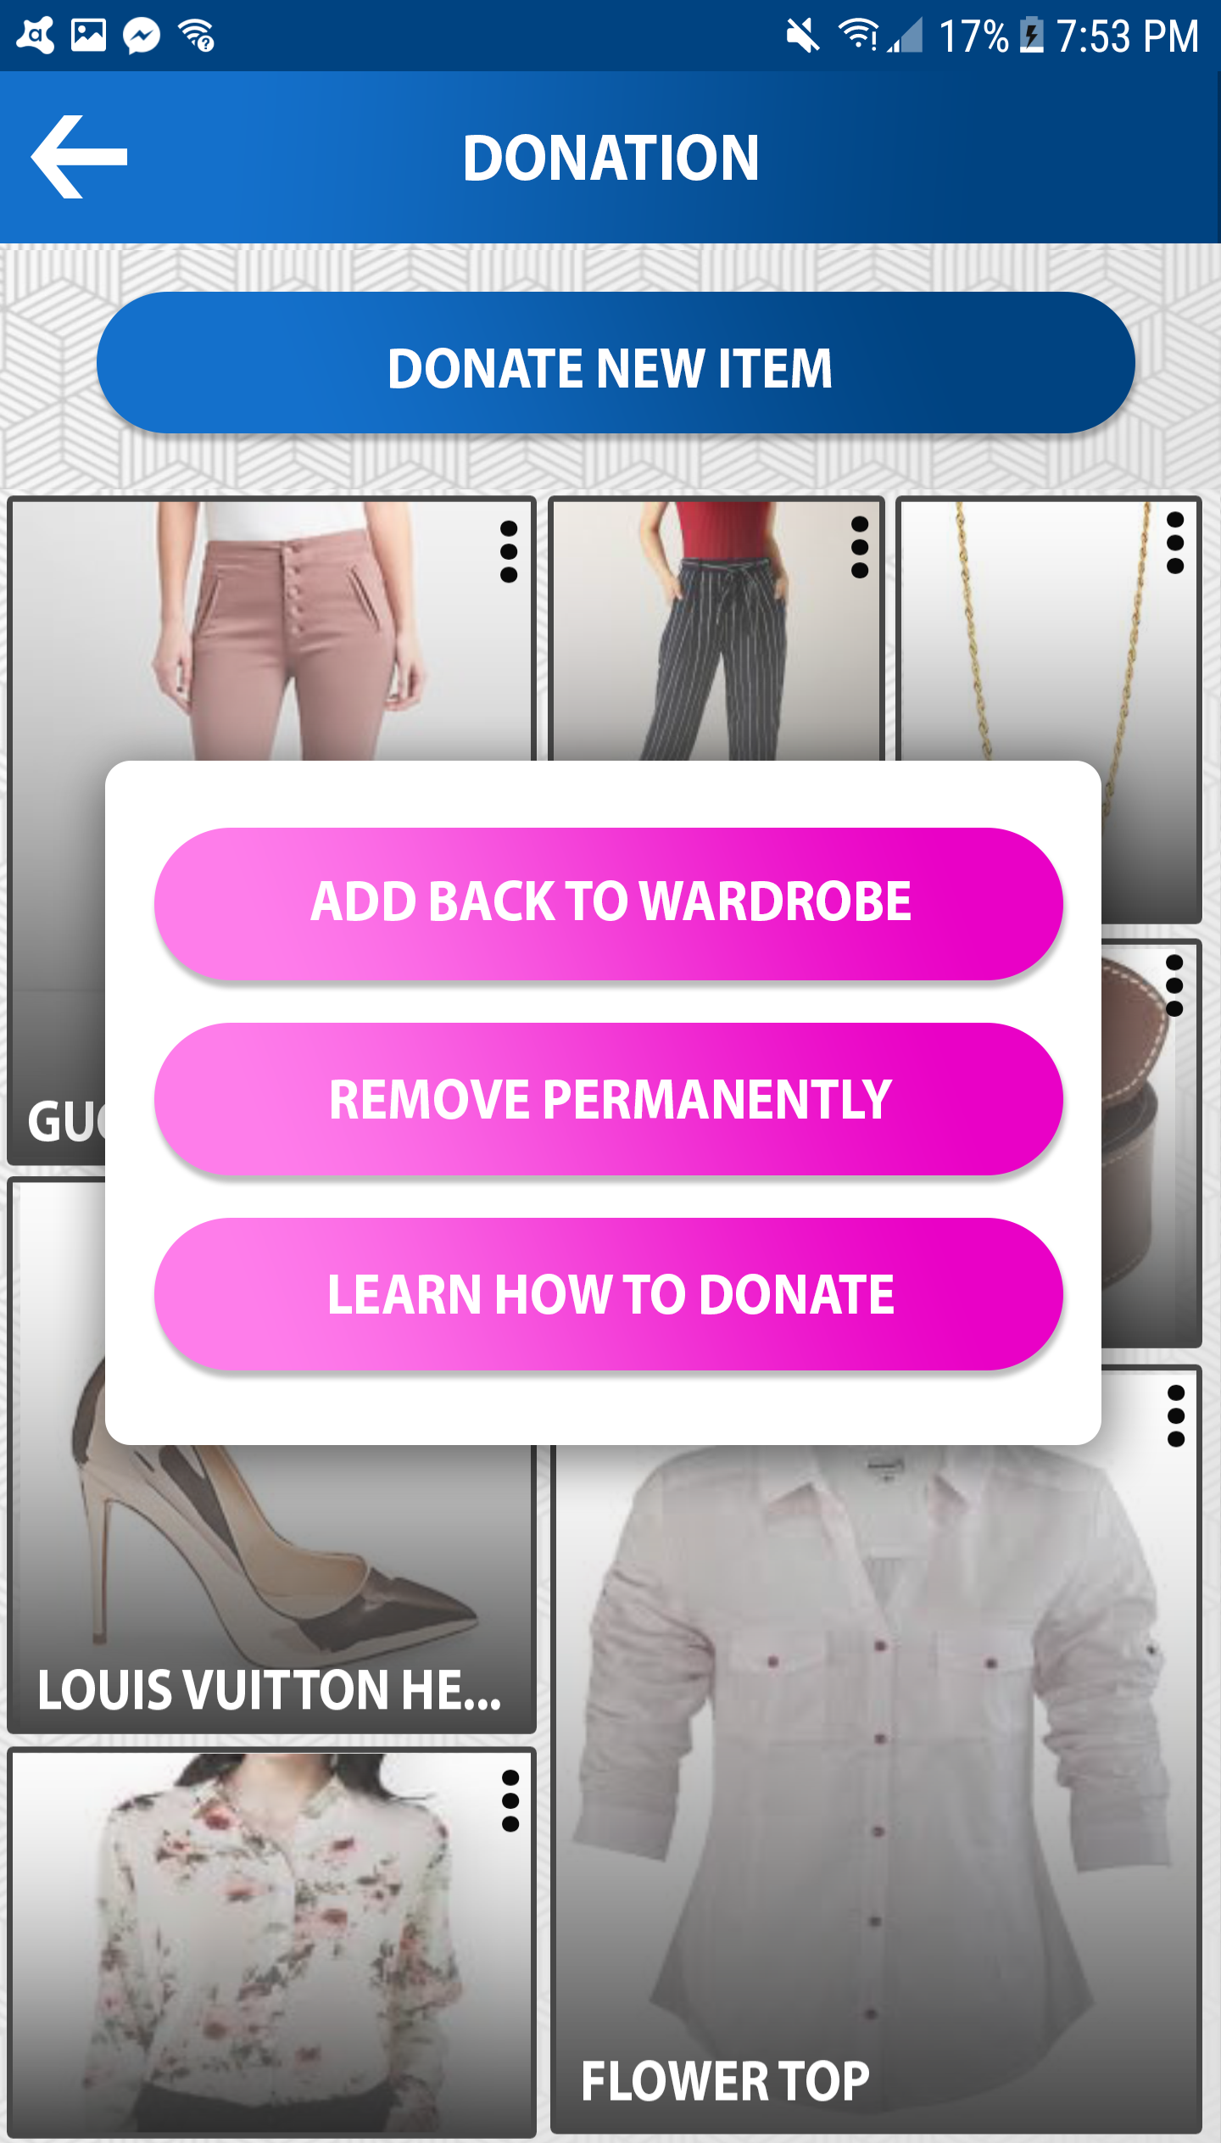
DONATIONS

Slide 22
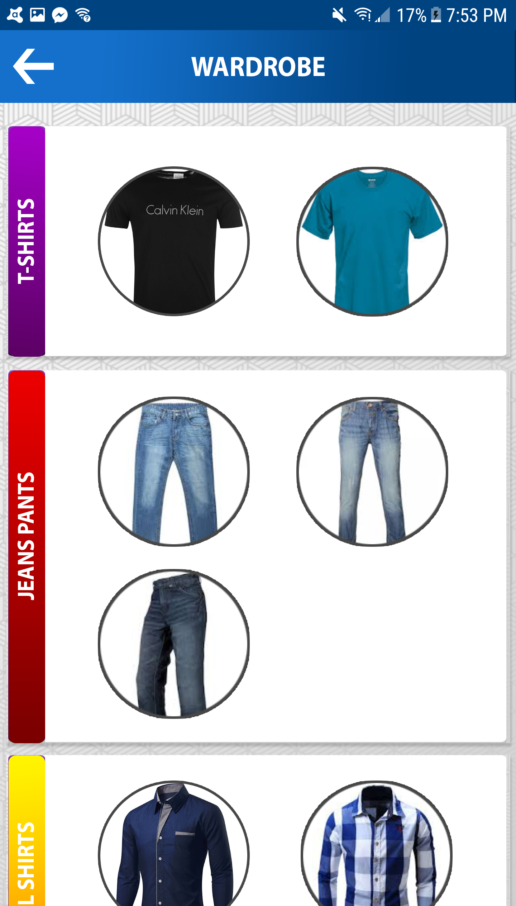
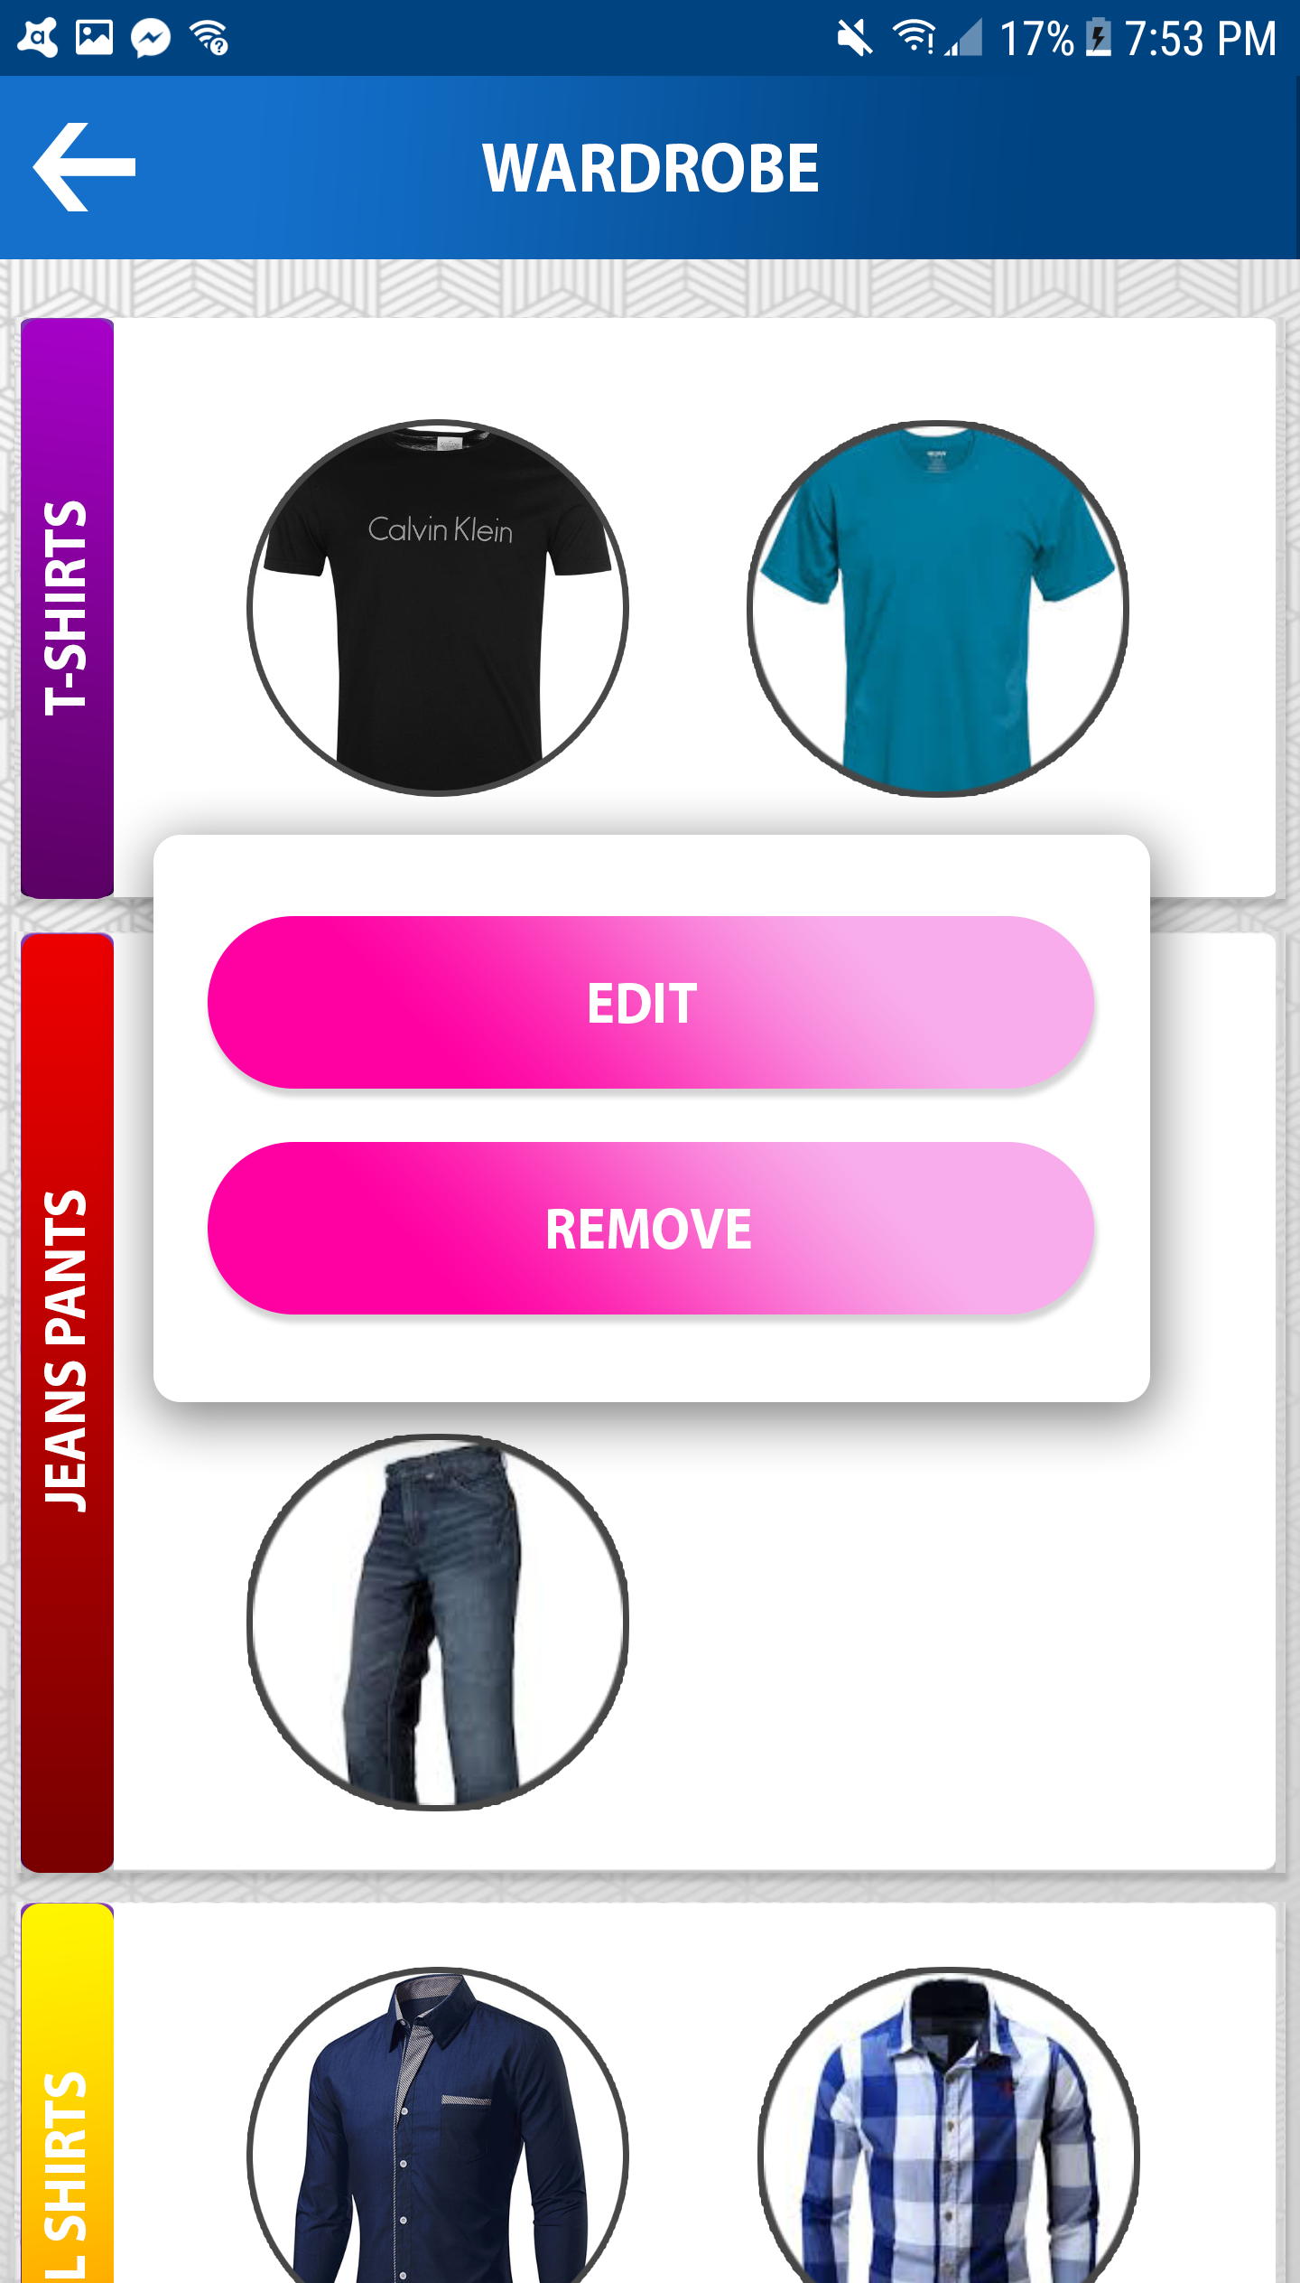
WARDROBE

Slide 23
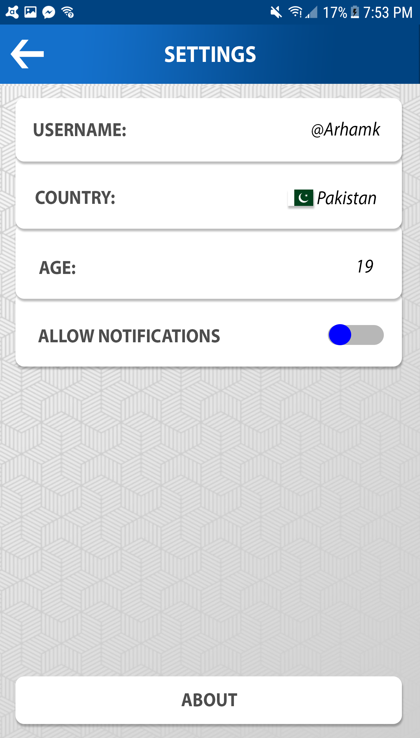
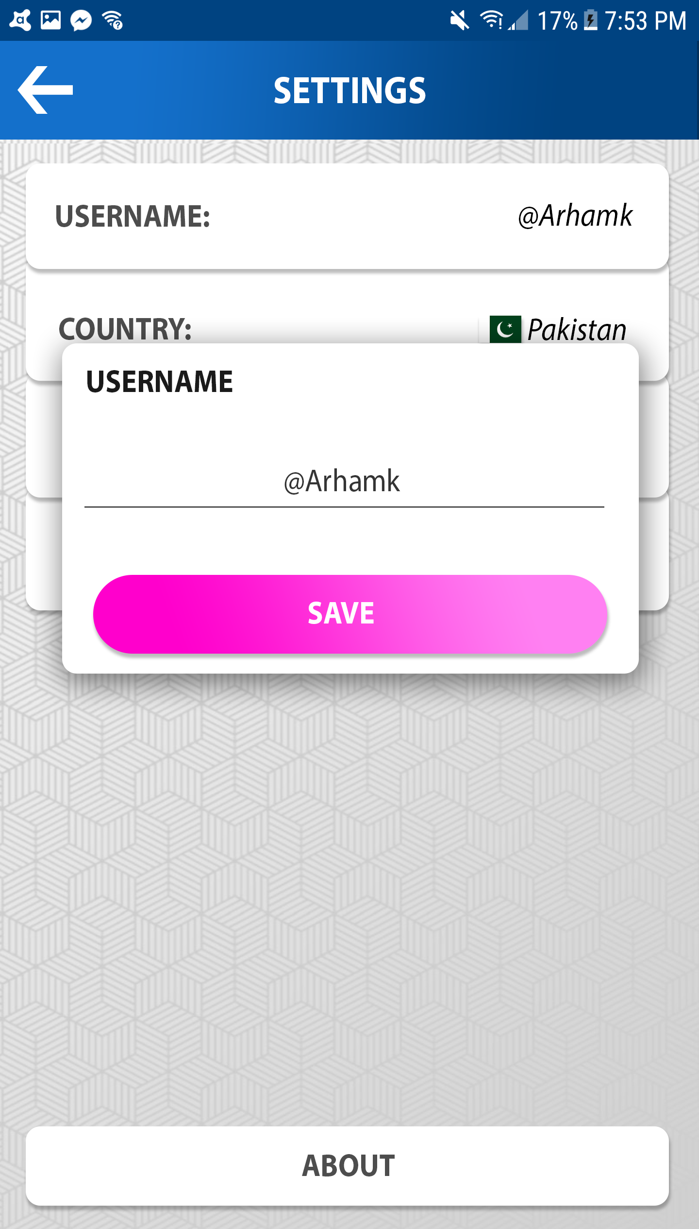
SETTINGS

Slide 25
COLOR IDEAS

Slide 26
DESIGN INSPIRATIONS

Slide 27
Fin.

